Slide 1
Chemistry Knowledge Organiser Topic 12: Quantitative Chemistry and Electrolysis
Key Terms | Definitions
Mole | 6.02x10²³ atoms of an element or molecules in a compound
Avogadro's number | 6.02x10²³ This is the number of atoms in 12 grams of carbon 12.
Relative Formula Mass | The total atomic mass of elements in compound
Limiting Reagent | The reagent which is used up first in a chemical reaction.
Relative formula mass (M_{r})
This is the mass in grams of 1 mole of the substance. To calculate it you need to add up the atomic mass (bigger number) of all of the atoms in the molecule.
e.g 1. NaCl = Na + Cl = 23 + 35.5 = 58.5
e.g 2. MgF₂ = Mg + (2 x F) = 24 + (2 x 19) = 62
Equation | Meanings of terms in equation
* $$moles= \frac{mass}{M_{r}}$$ | Mass is the mass of the substance in grams $M_{r}$ is the relative formula mass of the compound (or use the relative atomic mass if it is an element)
Higher tier-The Mole
A mole of an element is simply 6.02x10²³ atoms (this number is known as Avogadro's number). Obviously, if the atoms are larger then 1 mole of that atom will be heavier. For example, one mole of hydrogen atoms weighs 1 gram but 1 mole of carbon weighs 12 grams. To calculate the number of moles in an element you need to divide the mass by the relative atomic mass:
For example, how many moles are there in 6 grams of carbon?
6/12= 0.5
To work out the number of moles in a compound you divide the mass of the compound by the relative formula mass, for example how many moles in 30 grams of magnesium oxide (MgO)?
M_{r} of MgO=24+16= 40
Moles= 30/40=0.75
Calculating moles from masses -Higher Tier
If you know the mass of each reactant and product you can calculate a balanced equation from the masses, for example: Calculate the balanced equation when 12 grams of magnesium reacts completely with 36.5g of HCl, to make 47.5 grams of MgCI₂ and 1 gram of H₂
Mg + HCI → MgCI₂ + H₂
Step 1: work out the moles of each reactant and product.
Mg=12/24= 0.5 HCl=36.5/36.5= 1 MgCI₂ =47.5/95 = 0.5 H₂ = 1/2 = 0.5
Step 2 divide through by the smallest number
Mg=0.5/0.5=1 HCl= 1/0.5 = 2 MgCI₂ =0.5/0.5=1 H₂ = 0.5/0.5=1
Step 3 write the balanced equation:
Mg + 2HCI → MgCI₂ + H₂
Higher Tier: Calculating Masses in Reactions
An understanding of the mole will allow to calculate the mass made in a chemical reaction.
Take the chemical reaction below:
Mg + 2HCI → MgCI₂ + H₂
This equation shows that one mole of magnesium reacts with two moles of hydrochloric acid to produce one mole of magnesium chloride and one mole of hydrogen gas. Suppose you started with 5 grams of magnesium, how much magnesium chloride would you make?
Step 1: Calculate the moles of the element or compound you were given in the equation:
5/24=0.21 moles of magnesium
Step 2: Look at the balanced equation, you must therefore have 0.21 moles of magnesium chloride, as the ration between magnesium and magnesium chloride is 1 to 1.
Step 3: Calculate the M_{r} of the relevant product: what you want to find is the M_{r} of magnesium chloride:
M_{r} of MgCI₂ =24+35.5+35.5= 94
Step 4: Now find the mass that will be made from that number of moles of magnesium chloride
Mass = moles x M_{r}, so 0.21 x 94= 19.7 grams
Higher tier-Limiting Reagent
When a chemical reaction is carried out, one or more reagents are in excess and one reagent is the limiting reagent. The limiting reagent is the reagent which is used up first in a chemical reaction, if all of this reagent is used up the reaction can no longer continue, for example, if a tiny amount of sodium is dropped into a large bowl of water there are a lot more water particles that there are sodium atoms. We therefore say that the sodium is the limiting reagent and the water is in excess.
The amount of product formed is directly proportional to the amount of limiting reagent. Therefore if you double the amount of limiting reagent you will get double the amount of product.

Slide 2
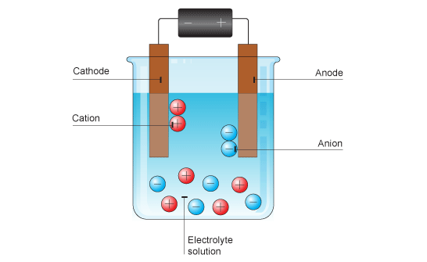
Chemistry Knowledge Organiser Topic 12: Quantitative Chemistry and Electrolysis
Key Terms | Definitions
Electrolysis | The breaking down of a substance using electricity
Electrolyte | The solution which is being broken down during electrolysis
Oxidation | The loss of electrons
Reduction | The gain of electrons
Anode | The positive electrode
Cathode | The negative electrode
Higher Tier - Concentration
Most chemical reactions are done in solution. The concentration can be measured in grams per dm³
For example what is the concentration of 2.4 grams of sodium chloride dissolved in 0.5 dm³ of water?
Conc= Mass/Vol
Conc= 2.4/0.5
Conc= 4.8 g/dm³
In Chemistry we use dm³ (decimetres cubed) to measure volume, a decimetre cubed is the same as a litre.
Equation | Meanings of terms in equation
* $$conc= \frac{mass}{vol}$$ | Mass is the mass of the substance in grams $Vol$ is the volume of the solution in dm³ Conc is the concentration in grams/dm³
Electrolysis
When an ionic compound is melted or dissolved in water, the ions are free to move about within the liquid or solution. These liquids and solutions are able to conduct electricity and are called electrolytes.
If an electric current is passed through this solution the ions will move to the electrodes. Remember-opposites attract. The positive ions (cations) will go to the negative electrode (cathode), the negative ions (anions) go to the positive electrode (anode).
For example in the electrolysis of lead bromide, Lead (Pb²⁺) goes to the negative electrode and bromine (Br⁻¹) goes to the positive electrode.
Oxidation, reduction and half equations-Higher
When a positive Ion reaches the negative electrode, it gains electrons. This is a reduction reaction.
When a negative ion reaches the positive electrode, it loses electrons, this is an oxidation reaction.
We can represent these using half equations A half equation can represent the reaction at each electrode. Half equations show how electrons are transferred and an electron is represented in an equation by an e⁻ symbol
Half equations show electrons (e⁻) and how ions become atoms.
E.g, Cu²⁺ + 2 e⁻ —> Cu.
1. Write down the ion and atom: Cl⁻ —> Cl₂
2. Adjust the number of ions (if needed) and add electrons to balance the charges if required 2Cl⁻ —> Cl₂ + 2 e⁻
Remember that non metal ions will typically form diatomic molecules.
Ionic equations-Higher
Half equations can be combined to form an ionic equation, which shows the overall reaction. For example in the electrolysis of copper chloride the two half equations are:
At the negative electrode (cathode):
Cu²⁺ + 2 e⁻ —> Cu
At the positive electrode (anode):
2Cl⁻ —> Cl₂ + 2 e⁻
Combing these 2 equations gives us:
Cu²⁺ + 2 e⁻ + 2Cl⁻ —> Cu +Cl₂ + 2 e⁻ The electrons either side of the equation cancel out, meaning the final ionic equation is:
Cu²⁺ + 2Cl⁻ —> Cu +Cl₂
In an ionic equation it is important to check both the atoms and the charges balance

Slide 3
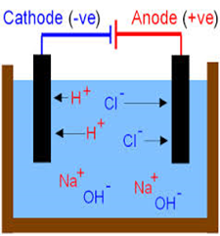
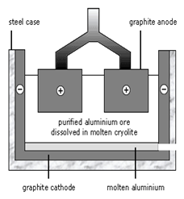
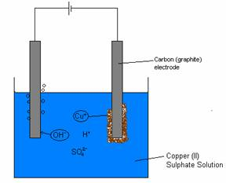
Chemistry Knowledge Organiser Topic 12: Quantitative Chemistry and Electrolysis
Electrolysis of Brine
Which elements form at which electrode depends on the reactivity of the elements involved.
For example , the electrolysis of brine is electrolysis of a solution of sodium chloride. However there are also H⁺ and OH⁻ ions form the water, which is used as the solvent. This means there is more than one possible ion that can go to each electrode.
· Positive ions: sodium (Na⁺) and hydrogen (H⁺)
· Negative ions: chlorine (Cl⁻) and hydroxide (OH⁻)
When there is a mixture of ions, the products formed depend on the reactivity of the elements involved.
Hydrogen is less reactive than sodium, so hydrogen gas (H₂) is produced at the negative electrode.
Chlorine gas (Cl₂) is produced at the positive electrode.Sodium hydroxide is produced from the ions that remain in solution.
Extracting Aluminium
Aluminium oxide is dissolved in molten cryolite .
Cryolite reduces the melting point of aluminium oxide meaning the process requires less energy.
Aluminium ions (Al+) are attracted to the negative electrode.
Aluminium atoms are formed at the negative electrode (gain 1 electron)
Oxide ions are attracted to the positive electrode
Oxygen is formed at the positive electrode (each ion loses 2 electrons)
Oxygen reacts with carbon to make carbon dioxide. This electrode needs to be replaced constantly.
At the negative electrode: At the positive electrode
Al³⁺ + 3e- —> Al 2O²⁻ —> O₂ + 4e-
Overall equation:
2Al₂O₃ → 4Al+3O₂
Electrolysis of Copper Sulphate
Which elements form at which electrode depends on the reactivity of the elements involved.
For example, in the electrolysis of aqueous copper sulphate is the electrolysis of copper sulphate, however there are also H⁺ and OH^{- I} ions form the water which is used as the solvent. This means there is more than one possible ion that can go to each electrode.
· Positive ions: sodium (Cu²⁺) and hydrogen (H⁺)
· Negative ions: sulphate(SO₄²⁻) and hydroxide (OH⁻)
When there is a mixture of ions, the products formed depend on the reactivity of the ions involved.
Copper is less reactive than hydrogen, so copper (Cu) is produced at the negative electrode.
The half equation is:
Cu²⁺ + 2e⁻ → Cu
The hydroxide ion is more reactive than the sulphate ion, therefore this forms water (H₂O) and oxygen at the positive electrode.
4OH⁻ → O₂ + 2H₂O +4 2e⁻
As a rule if a halide ion is present , this will form at the positive electrode, however if no halide is present then oxygen and water will form at the positive electrode.
Electrolysis of Copper Sulphate

Slide 4
Chemistry Knowledge Organiser Topic 12: Quantitative Chemistry and Electrolysis
Rules for Aqueous Solutions
On the previous page there are 2 specific examples of the electrolysis of aqueous (dissolved in water) solutions, however below are the general rules for any aqueous solution and remember they may give you questions on unfamiliar contexts during the exam.
If the positive ion in the solution is less reactive than hydrogen (for example copper) the metal will form at the negative electrode. If it is more reactive than hydrogen (for example sodium) then hydrogen will form at the negative electrode.
At the positive electrode oxygen will always form (due to the movement of hydroxide ions) unless there is a halide ion present (F⁻,Cl⁻, Br⁻, I⁻), in which case the halogen molecule will be produced at the positive electrode, for example Cl₂
Remember the reason this happen is because water is in an equilibrium as a water molecule and hydrogen and hydroxide ions. See more on equilibrium in topic 18.
Gas Tests
During electrolysis the products made are often gases. Below are the tests for three common gases you need to know:
Gas | Test | Result
Hydrogen | Place a lit splint into the gas | If a squeaky pop is heard hydrogen is present
Oxygen | Place glowing splint into gas | If splint is relighted then oxygen is present
Chlorine | Damp litmus paper placed in gas | If paper bleaches, chlorine is present
Carbon Dioxide | Bubble the gas through limewater | If the limewater goes cloudy carbon dioxide is present

Slide 5
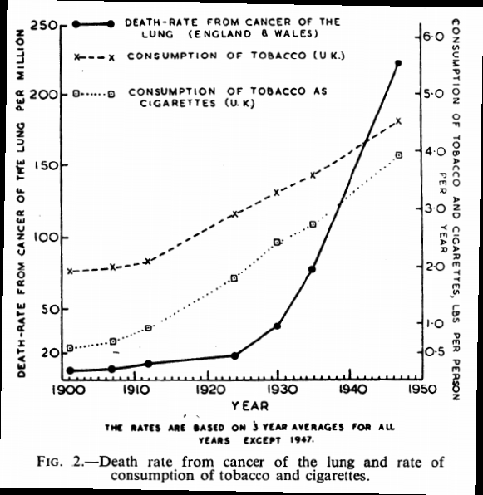
Biology Knowledge Organiser Topic 13: How do Organisms get Sick?
Key Terms | Definitions
Disease | Any condition that reduces health/causes ill-health.
Communicable | Type of disease that can be passed on. These diseases are caused by pathogens, such as viruses. Be clear that the pathogen is the microorganism, and the disease is the collection of symptoms resulting from infection by the pathogen.
Non-communicable | Describes diseases that are not caused by pathogens and cannot be passed on. These are often caused by many factors acting together, known as risk factors for the disease.
Pathogen | A microorganism that can infect another organism (a host) and cause disease in that organism. E.g. bacteria and viruses.
Risk factor | Any factor that increases the chance of developing a non-communicable disease, such as smoking or diet.
Health and disease
Health is the state of physical and mental wellbeing. So, ‘good health’ involves good physical and mental wellbeing. ‘Poor health’ involves problems with one or both aspects. Diseases are major causes of ill-health. Diseases can be classified as communicable (can be passed on, as they are caused by pathogens) and non-communicable (cannot be passed on). Other factors affect health: such as diet, lifestyle, stress, and genetic inheritance, for instance. Often, ill-health is caused or made worse by an interaction of different factors. Some examples:
If their immune system has a defect, someone is more likely to suffer from communicable diseases, since their body will be worse at fighting pathogens.
Some viruses, which live inside cells, can trigger cancers. For instance, the HPV virus can trigger cervical cancer (hence the vaccine in year 9 for girls).
Severe physical health problems can lead to mental health problems, such as depression.
Immune reactions to infection by a pathogen can trigger allergic reactions, like skin rashes or asthma.
Non-communicable diseases
Diseases that are not caused by pathogens – non-communicable diseases – are often linked to many different risk factors, and these factors may interact to increase the risk. These risk factors may come from someone’s lifestyle, or from substances in their body or substances in their environment. In some cases, the link between a risk factor and a particular disease is very clear: we know the risk factor actually causes the disease. For other risk factors, we know the linked diseases but not really how the risk factor causes them.
Here are some causal links we do know:
Poor diet, lack of exercise and smoking have a proven link to cardiovascular disease.
Obesity can cause type 2 diabetes.
Alcohol causes liver damage and damages brain function.
Smoking causes lung cancer and other lung diseases (like emphysema).
Smoking and drinking alcohol during pregnancy causes problems in unborn babies.
Carcinogens, such as ionising radiation (next topic), can cause cancer.
It is important to realise that while these risk factors are real, they don’t guarantee the disease. E.g. not ALL obese people will get type 2 diabetes; however, being obese greatly increases the risk of developing the disease.
Using data to discover risk factors
Risk factors aren’t always obvious: it requires scientific research to find out what factors are linked to what disease. For many years, people smoked cigarettes thinking it was perfectly healthy (including doctors!). However, research by a scientist called Richard Doll showed that increased use of tobacco in the UK was linked to increased incidence of lung cancer (incidence is just how many people get it), as the graph shows (from his 1950 publication). He sampled the population and found this correlation between the risk factor (smoking) and the disease (lung cancer).

Slide 6
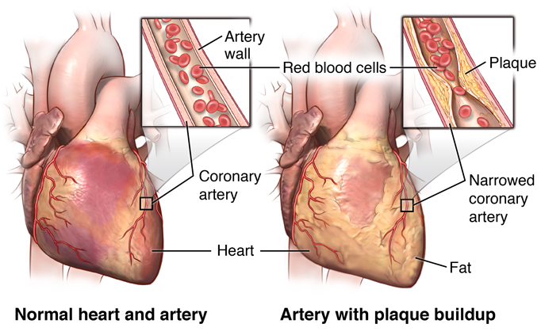
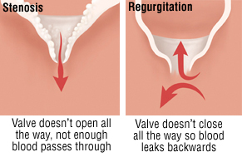
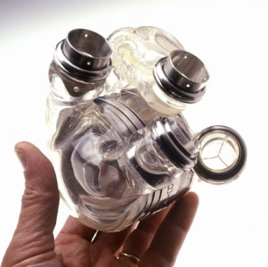
Biology Knowledge Organiser Topic 13: How do Organisms get Sick?
Key Terms | Definitions
Coronary | To do with the heart, especially the blood vessels that supply the heart muscle with blood.
Stent | A mesh or cage-like structure that keeps coronary arteries open so blood can flow through.
Statins | Medicinal drugs used to lower blood cholesterol. High blood cholesterol is a risk factor for coronary heart disease.
Valve | Structures in the heart that prevent blood flowing the wrong way.
Heart failure | Where the heart cannot pump blood around the body properly.
Coronary heart disease: a non-communicable disease
Recall that coronary arteries are the arteries that provide the heart muscle with blood, so they get oxygen and glucose (and to take away waste products). Coronary heart disease involves the narrowing of these arteries, due to the build up fatty material (called a plaque – see diagram) in there. This reduces the blood flow through the coronary arteries, so the heart muscle receives insufficient oxygen. When serious, this leads to a heart attack (where part of the heart muscle dies due to lack of oxygen).
Treatments for coronary heart disease:
Insert a stent into the narrowed artery to widen it again. This is a kind of wire mesh that pushes the artery walls out and keeps the artery open.
Take statins. These drugs reduce blood cholesterol levels, which is linked to the fatty material deposits. Lowering cholesterol reduces the rate of fatty material build up.
Other heart diseases
The valves in the heart are vital to prevent blood flowing in the wrong direction. In some people there is fault in the heart valves. The valve may get a leak, or might not open fully – see diagram.
If one or more of the valves leaks, blood flows backwards in the heart. This means the blood does not transport oxygen as efficiently and also increases the risk of infection in the heart.
If a valve doesn’t open fully, the heart has to work harder to pump the blood as your body requires. This increases strain on the heart, making other heart problems more likely.
These valve problems can be treated
by replacing the valves. Replacement
valves can be biological – from a living
organism (including pigs! Their heart is
the same size as ours so their valves
fit) or mechanical – a synthetic version.
See the photos – mechanical on the right.
Heart transplants
If the heart fails (called heart failure) and cannot be repaired, the heart can be transplanted. In fact, the heart and lungs can be transplanted together if required. The replacement heart has to come from a donor – many people agree to donate their organs after they die to save the lives of others.
However, there is a shortage of donor organs, like hearts. So people with heart failure may have to wait a while. In this case, artificial hearts can be used to keep someone alive while they wait. These are pretty amazing – have a look at the photo.

Slide 7
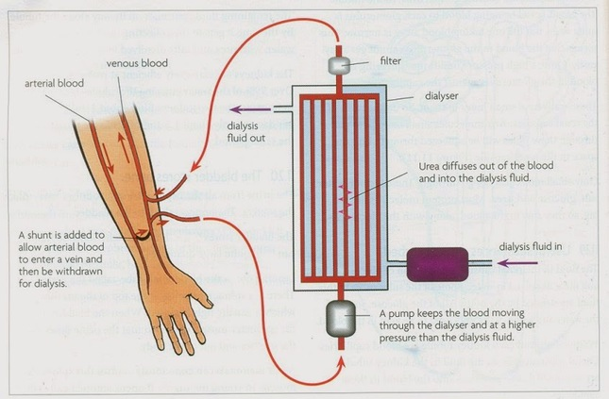
Biology Knowledge Organiser Topic 13: How do Organisms get Sick?
Key Terms | Definitions
Dialysis | Treatment for kidney failure, in which a machine filters toxic substances from the blood instead of the kidneys.
Diabetes | Condition where blood glucose concentration is not controlled properly by the body.
Insulin | The hormone, produced in the pancreas, that reduces blood glucose concentration by making cells absorb glucose from the blood.
Immunosupp-ressant | Type of drug that reduces the responses of the immune system. This makes sure that ‘foreign’ organs (like a transplanted kidney) are not fought by the immune system – a situation called rejection.
Kidney failure
If they kidneys fail, it is extremely dangerous. Kidney failure can be treated by a kidney transplant or using kidney dialysis. A transplant has the benefit for the patient of not needing to spend lots of time on a dialysis machine. However, they need to take immunosuppressant drugs to prevent rejection of the transplanted kidney. These leave them more susceptible to infections.
Dialysis machines keep people with kidney failure alive because they filter the blood for them. However, the patient would need to spend many hours a week connected to the machine to prevent urea reaching unsafe levels in the bloodstream.
The dialysis machine works as shown in the diagram. Notice that inside the machine, there is a large surface area to increase the rate of diffusion of urea out of the bloodstream.
Diabetes – a non-communicable disease
Diabetes is a group of disorders where blood glucose cannot be properly regulated by the body, which is potentially very dangerous. There are two types, with different causes and treatments.
Type 1 diabetes | Type 2 diabetes
Caused by a defect in the pancreas, where the cells that produce insulin don’t work. | There is no problem with the pancreas – it produces insulin as usual. BUT, body cells no longer respond to the insulin.
The effect: Blood glucose concentration cannot be controlled by the body. | The effect: Blood glucose concentration cannot be controlled by the body.
Treatment is injections of insulin. | Insulin injections will have no effect, so the treatment is a carbohydrate-controlled diet and exercise.
The cause is unknown, but we do know it involves the insulin-producing cells getting destroyed. | Obesity is a major risk factor for type 2 diabetes. There is also a genetic risk factor.

Slide 8
Biology Knowledge Organiser Topic 13: How do Organisms get Sick?
Key Terms | Definitions
Mutation | Change to DNA, altering its function (this is not necessarily dangerous). In cancer, a specific mutation causes cells to divide uncontrollably.
Protist | Whole kingdom of organisms, including some that cause disease.
Transmission | The passing of a pathogen from one organism to another, leading to the spread of communicable (infectious) disease.
Host | The organism that a pathogen lives in or on. When you have a cold, you are the host for the cold virus.
Cancer – a non-communicable disease
Cancer is a non-communicable disease. There are many types of cancer, but they all involve changes in cells (mutations) that lead to the cells growing and dividing in an uncontrolled way. Normally, the cell cycle (see topic 6) controls cell growth and division, so the body only replaces lost cells. However, in cancer, the control mechanisms are broken and cells divide out of control, producing a mass of cells called a tumour.
Benign tumours are growths of abnormal cells, but these do not invade other parts of the body. This is because the tumour is restricted to one area and often surrounded by a membrane. This makes them much less dangerous than malignant tumours.
Malignant tumours cause cancer as you’d normally think of it. The cells grow out of control and invade nearby tissues. When mutated cells break off the tumour and get into the bloodstream, the cancer can spread around the body. The mutated cells can then cause more tumours, elsewhere. These are called secondary tumours.
In terms of risk factors for cancer, some are very clearly identified (like smoking as a risk factor for lung cancer). There can be genetic risk factors for some types of cancer (so the risk factor is inherited from the parents).
Spread of communicable diseases is caused by the transmission of pathogens
A big problem with pathogens is that they can be passed from one host to another, so the disease they cause can spread. See the table for the methods by which pathogens can be transmitted.
We can attempt to reduce the transmission of pathogens by: vaccinating people; destroying vectors (e.g. killing mosquitos with pesticides); being hygienic (i.e. washing our hands!); isolating people who are infected in special hospital wards.
Communicable diseases and pathogens
Communicable diseases are sometimes called infectious disease, since they always result from an infection by a pathogen. All organisms can be infected by pathogens, so all organisms can suffer from communicable diseases (yes, including plants, and even bacteria can be infected by viruses!). You need to know details of specific diseases (next page), but here is a general description of how each kind of pathogen causes disease:
Bacteria can cause disease if they enter our bodies. They reproduce rapidly and can release poisonous chemicals, called toxins, that damage our cells. Examples of diseases caused by pathogenic bacteria include cholera, tuberculosis (TB) and food poisoning.
Viruses need a host to survive. They cause disease symptoms by reproducing inside cells, and bursting the cell from the inside. This releases them, so they can be passed onto other host cells or other people (e.g. by coughing or sneezing out mucus that contains the viruses).
Fungi can also cause disease, by growing on living tissue (for example, athlete’s foot is caused by a fungus).
Protists can cause disease, as they can live in host organisms. A good example is the malarial protist, that causes malaria.
Direct types of transmission | Indirect types of transmission
Direct contact e.g. shaking hands or kissing | A vector (animal) carries the pathogen e.g. mosquitos carry the pathogen that causes malaria
Sexual contact | Droplet infection: droplets of mucus containing a pathogen are sneezed or coughed out by an infected person, and breathed in by someone else. We can also say the pathogen is airborne.
From mother to foetus over the placenta | Waterborne – the pathogen infects water and moves between people when they drink the water

Slide 9
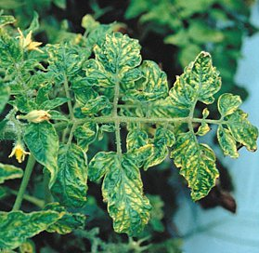
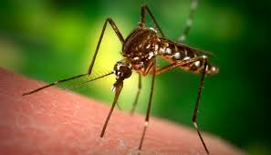
Biology Knowledge Organiser Topic 13: How do Organisms get Sick?
Key Terms | Definitions
Fever | Disease symptom linked to raised body temperature, thanks to disruption of the normal homeostasis mechanisms.
HIV | Human Immunodeficiency Virus. A virus that uses immune cells as host cells. HIV infection causes AIDS, but if treated properly, AIDS will never develop in an infected individual.
AIDS | Acquired Immunodeficiency Syndrome. A condition in which the immune system is seriously weakened due to infection by the HIV virus.
Salmonella | A genus of bacteria that can cause food poisoning.
Discharge | A substance being produced by the body that should not be there – a sign of disease.
Viral diseases
Measles is caused by a virus. It is spread by droplet infection: you’d catch it if you inhaled the droplets containing the virus that someone infected coughed or sneezed out. The symptoms include fever and a red rash on the skin. Measles is a serious disease – it can even be fatal if there are complications. So, most young children are vaccinated against measles.
HIV is a virus that can only be spread by exchange of body fluids: sexual contact or when blood is mixed – which can happen when intravenous drug users share needles. HIV cannot be transmitted by kissing or by droplet infection. Infection with HIV causes flu-like symptoms first, but these go away after a couple of weeks. However, the virus has not gone from body – it is living inside immune cells (white blood cells). HIV is NOT the same thing as AIDS, but AIDS can arise from infection by HIV unless treatment takes place. The treatment is antiretroviral drugs (so called because HIV is a type of virus called a retrovirus). Without this treatment, AIDS will occur. Here, the body’s immune system is so badly damaged it cannot
fight off other infections or cancers – so it is very serious.
Tobacco mosaic virus (TMV for short) is a pathogen affecting plants.
In spite of its name, it affects many species of plant (including
tomatoes – see photo). TMV causes discolouration of the leaves,
giving a mosaic pattern. This hinders photosynthesis, so plants
don’t grow very well if they are infected by TMV.
Fungal diseases
Rose black spot is a fungal disease that affects plants.
It causes purple or black spots to develop on leaves
(hence the name – see picture). The whole leaf often
turns yellow and drops early (i.e. before autumn). Like TMV, the plant’s growth is inhibited because the rate of photosynthesis is reduced. The fungus is spread on the wind or in water, transmitting the pathogen to other plants. Treatment options: remove the affected leaves, or use a fungicide (a chemical that kills fungi).
Bacterial diseases
Salmonella food poisoning is caused by a bacteria found in food, or on food where it is prepared in unhygienic conditions. The bacteria can be found in poultry (e.g. chickens), so these animals are vaccinated against Salmonella to reduce the spread of the pathogen. Inside the body, the bacteria reproduce and produce toxins which cause disease. Symptoms of Salmonella food poisoning include: fever, abdominal cramps, vomiting and diarrhoea.
Gonorrhoea is the name of a sexually transmitted disease (STD or STI), rather than the name of the pathogen. The pathogen is a bacterium that is transmitted by sexual contact, so transmission can be prevented with a barrier-type of contraception, like a condom. The symptoms include a thick yellow or green discharge from the vagina or penis and pain when urinating (weeing). It used to be that gonorrhoea was easily treated with an antibiotic (penicillin, in this case), but there are now many resistant strains of bacteria that cause gonorrhoea. (Resistant strains are species of the bacteria on which certain antibiotics do not work.)
Protist diseases
Malaria is a disease caused by a protist (see topic 6 for a reminder). The protist has a life cycle that requires it to live inside a mosquito for some of the life cycle, and in the body of a mammal – like a human – for other stages of the life cycle. In the mosquito, the protist is found in the salivary glands, which is why the protist can be transmitted to a person when the mosquito sucks their blood. The mosquito acts as a vector. In the human, the
protist causes malaria. Symptoms include
recurrent (repeating) fever and malaria can be
fatal. We can attempt to reduce transmission
by targeting the mosquitos: preventing them
breeding and avoiding bites using mosquito nets.

Slide 10
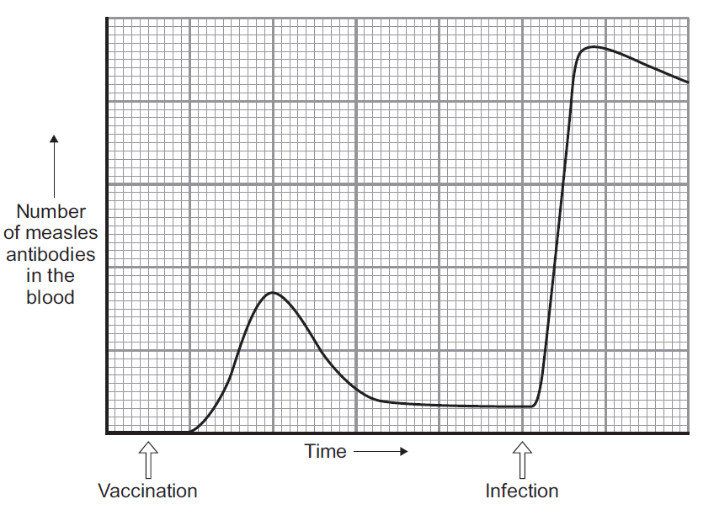
Biology Knowledge Organiser Topic 13: How do Organisms get Sick?
Key Terms | Definitions
Defence systems | Structures and mechanisms we have to prevent pathogens entering the body, and to fight them off if they do enter. Includes non-specific defences (act on any pathogen) and specific defences (target the particular pathogen you’ve been infected by).
Mucus | A sticky substance produced by many epithelial (surface-covering) tissues in the body, to trap dust particles and microorganisms so they can’t enter the body.
Antibody | Chemical produced by white blood cells that destroys specific pathogens.
Antitoxin | Chemical produced by white blood cells that neutralises specific toxins.
Human defence systems
Pathogens are all over the place, so humans have evolved defence systems to deal with them. We have non-specific defences, which keep pathogens from entering the body (although, of course, they can fail to do this – otherwise you’d never get sick!). If pathogens do get in, we have the immune system, which destroys the pathogen inside the body.
Non-specific defences:
The skin! Our main barrier against pathogens getting in. The vast majority of pathogens cannot get through the skin at all – they have to enter somewhere else. Also, the skin scabs over to provide a quick barrier if there is a cut or wound.
The nose has hairs and mucus to trap microorganisms so they don’t get any further than the nose. If you don’t blow your nose, the mucus ends up in the back of the throat and you swallow it – this is harmless, because the stomach acid kills any microorganisms in there.
The trachea and bronchi also contain mucus. This traps microorganisms that are breathed in, and the mucus, again, can be swallowed harmlessly.
The stomach produces hydrochloric acid (at pH 2), which kills most microorganisms that are swallowed.
The immune system responds if pathogens enter the body properly – i.e. if they get into the bloodstream. The most important cells in the immune system are the white blood cells. They help defend against pathogens by:
Phagocytosis. This is the engulfing and digesting of pathogens
by white blood cells, destroying the pathogens.
Antibody production. White blood cells produce chemicals
called antibodies that bind to pathogens and destroy them.
These are specific, meaning only one particular antibody type
will bind to one particular pathogen.
Antitoxin production. Some pathogens, especially bacteria,
produce poisonous toxins. These are neutralised by antitoxins
– another sort of chemical produced by white blood cells.
Again, antitoxins are specific to specific toxins.
Vaccination
Vaccination is great on two fronts: it stops the vaccinated individual from getting ill AND it helps prevent the spread of communicable diseases. If a large proportion of the population is vaccinated, it is very unlikely that an unvaccinated person would be exposed to the pathogen, so everyone is protected.
A vaccine contains a small quantity of a dead or inactive form of a pathogen (usually a virus, such as the measles virus – see graph).
Delivering a vaccine stimulates a primary immune response. White blood cells produce antibodies to destroy the pathogen, but this is slow.
Specialised white blood cells (memory cells) remain in the blood afterwards.
This means that if an infection by the real pathogen takes place in the future, there is a secondary immune response by the white blood cells, which is quicker than the primary immune response.
The secondary immune response starts faster (see graph), involves the production of far more antibodies (a stronger response) and the level of antibodies stays higher for longer.
This means the pathogen is destroyed before you even realise you are ill.

Slide 11
Biology Knowledge Organiser Topic 13: How do Organisms get Sick?
Key Terms | Definitions
Drug | Any chemical that causes chemical changes in the body. Most drugs are medical – used to treat disease.
Antibiotic | Type of drug that treats bacterial disease by killing pathogenic bacteria.
Antiretroviral | Type of drug that can kill viruses: these are used to treat infection by HIV.
Painkiller | Drug that only treats the symptoms of disease, rather than killing pathogens.
Symptoms | Problems with the body arising from disease and indicating that there is a disease. E.g. coughing, headaches, vomiting.
Toxicity | From ‘toxic’, toxicity means how harmful a drug is to healthy body tissues.
Efficacy | How well a drug actually treats the disease it is designed to treat.
Dose | How much of a drug is given to a patient, and how many times a day and so on.
Treating disease with drugs
Despite our non-specific defences and our immune systems, we still get sick due to communicable diseases. Fortunately, we’ve developed a huge range of drugs to treat diseases. (Drugs and medicines are synonymous; we can also say ‘medical drugs’ to mean those that treat disease rather than drugs taken for recreation.)
Antibiotics
Antibiotics have only been produced since the 1940s, but they have changed the world in that time. The first antibiotic was discovered (not made – it was produced by a fungus!) by Alexander Fleming. He found that a fungus called Penicillium worked to kill bacteria he was growing in an agar plate. Named for the fungus that produced the chemical, this was the first antibiotic: penicillin. It is still used today.
Antibiotics treat bacterial diseases only, because they kill pathogenic bacteria in the body. In this way, they can cure bacterial diseases. Antibiotics are specific – so you need to use the right antibiotic to kill the particular bacteria that has infected you. So, antibiotics have saved millions of lives, by successfully treating people with bacterial infections. However, a big issue with the use of antibiotics is that many strains (types) of resistant bacteria have emerged (more on this in topic 16).
Antibiotics CANNOT kill viruses, so cannot treat viral diseases. Since viruses live inside host cells, it is very difficult to kill viruses without also damaging the body tissues they live in.
Painkillers
Painkillers are examples of medical drugs that treat the symptoms of disease, without actually getting to the cause and killing the pathogens. An example is aspirin, a painkiller that was first extracted from the bark of willow trees.
Development and testing of new drugs
New chemicals, potential medical drugs, are tested to find out if they are safe and effective (they actually treat the disease they are supposed to!). There are many stages to this testing. We refer to the part before giving the drug to humans as ‘preclinical testing’ and to the stages where humans received the drugs as ‘ clinical trials’. Together, these stages tell us about the drug toxicity, efficacy and information about the dose that should be given. Here’s the sequence:
Preclinical testing is in a lab. The drug is tested on cells and tissues grown for drug testing, and on animals like rats bred for drug testing. This checks that the drug is not toxic, and can give information about efficacy too.
Clinical trials are tests on humans. First, new drugs are given in very low doses to healthy volunteers, to check that they are not toxic and don’t cause major side effects.
If the drug is safe, clinical trials using people with the disease take place. These trials test how well the drug works for the disease, and identifies the optimum dose.
In any clinical trial, double blind testing is often used. Some patients are given a placebo (fake version of the drug), and neither scientist/doctor or patient know who has the placebo and who has the real drug until afterwards. This ensures that effects due to people’s expectations can be ruled out.
Discovering new drugs
There is a constant demand for new drugs – for better treatments, to treat diseases without any current cures, and to deal with antibiotic resistance. Chemicals that might work as effective drugs are constantly being discovered or synthesised in labs. Many drugs were discovered in living organisms: e.g. the heart drug digitalis originates from foxgloves. There are other examples above. However, any of these newly discovered/made chemicals must be thoroughly tested before they can be used in humans.

Slide 12
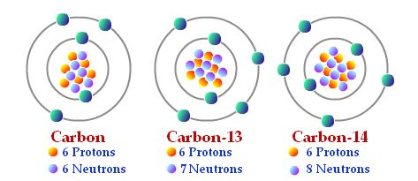
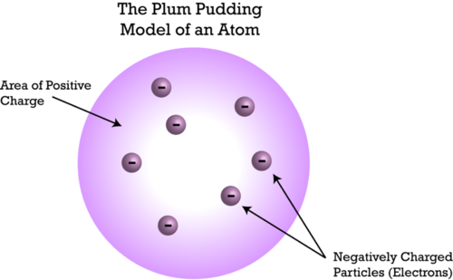
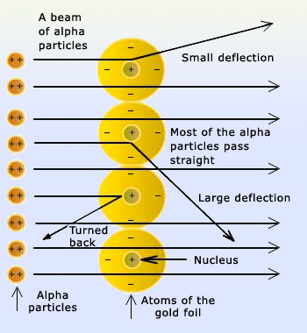
Physics Knowledge Organiser Topic 14: Nuclear Physics
Key Terms | Definitions
Isotopes | Isotopes of an element have the same number of protons but different numbers of neutrons in the nucleus.
Energy level | The other name for electron ‘shells’. Each energy level is a specific distance from the nucleus and holds a limited number of electrons.
Radioactive decay | The process of an unstable nucleus becoming stable and giving out nuclear radiation in the process.
Nuclear radiation | Types of radiation that come from the nucleus of atoms during decay. Four types: alpha, beta, gamma, and neutrons.
The structure of the atom and isotopes
You’ve already studied the structure of the atom – the small central nucleus surrounded by electrons – in the first chemistry topic. Go back and recap that first.
An important point about the shells, or energy levels, where electrons are found is that the energy level of an electron can change:
Electrons move up an energy level with the absorption of a specific wavelength of EM radiation
Electrons move down an energy level by emitting a specific wavelength of EM radiation.
Atoms of a particular element always have the same number of protons (the atomic number in the periodic table). However, they don’t all have to have the same number of neutrons to be the same element. If the number of neutrons varies between atoms of an element (but number of protons stays the same), we call the atoms isotopes of the element. Look at the diagram for the example of three isotopes of carbon.
How the modern model of the atom was developed
The model of the atom that you know all about has changed over time. Here’s a brief timeline:
Before electrons were discovered, atoms were thought of as simply tiny, hard spheres that couldn’t be divided into smaller particles.
Electrons were discovered (which are smaller than atoms!), so the model was modified. The plum pudding model of the atom was described: the atom as a ball of positive charge with negative electrons embedded in it like pieces of fruit in a pudding (see diagram).
A famous experiment by the scientists Rutherford and Marsden showed that the plum pudding model was wrong. Particles named alpha particles (more on these later) were fired at a sheet of atoms and some rebounded, some were deflected and others went straight through (see diagram). This showed that atoms have a hard, very small concentration of mass in the centre – which was named the nucleus. It also showed that the nucleus was charged, and we now know that is due to the protons in the nucleus. This model, that you use, is sensibly called the nuclear model of the atom.
The nuclear model was further developed to include the idea that electrons orbit at specific distances from the nucleus: in energy levels. The key scientist presenting this model was Niels Bohr.
Next, the nucleus was investigated further. It was found that the nucleus can be split up, producing particles with an equally-sized positive charge. These particles are named ‘protons’ – of course!
Then, in 1932, a scientist named James Chadwick proved that there were also uncharged particles in the nucleus. He called these particles ‘neutrons’ as they are neutral: no charge. This was about 20 years after the nucleus had already been accepted as the right idea about atoms.
Radioactive decay
Some atomic nuclei are unstable. For instance, carbon-14 above is unstable. The nucleus will spontaneously and randomly change to become more stable. When the nucleus does this, it gives out nuclear radiation.
Since it is a random process, it is impossible to predict which particular nucleus will decay next. However, with a huge number of them, it is possible to measure the rate at which the whole source of radiation is decaying. This rate is measured in number of decays per second: the unit is the becquerel (Bq). One Bq = 1 decay per second. This can be measured with a detector called a Geiger-Muller tube – in this case, 1 Bq = 1 count per second.

Slide 13
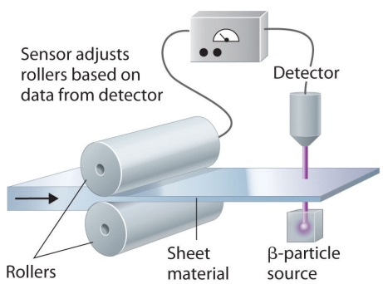
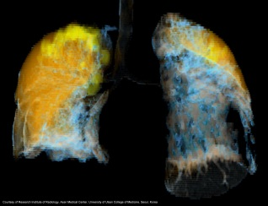
Physics Knowledge Organiser Topic 14: Nuclear Physics
Key Terms | Definitions
Emission | Releasing or giving out. Nuclear radiation is emitted during radioactive decay.
Penetration | Passing through a material. Different types of nuclear radiation can penetrate different materials, and are absorbed by certain materials.
Ionisation | The process of making an ion by ‘knocking off’ electrons. Ionising radiation causes this, and can break up molecules into ions which go on to react with other chemicals. This is very dangerous in living organisms.
Types of nuclear radiation
As you’ve seen, the rate of decay is measured in Bq, or can be measured as the count rate in Bq. What it actually ‘counts’ is the amount of radiation hitting the detector each second. The radiation emitted from the nucleus thanks to radioactive decay can be:
An alpha particle (symbol: α). An alpha particle is made of two protons and two neutrons (making it identical to the nucleus of helium atoms). Since there are four subatomic particles in one alpha particle, it has a mass number of 4. Since there are two protons in an alpha particle, it has a proton number of 2.
A beta particle (symbol: β). A beta particle is a high speed electron. Beta particles are emitted during a type of radioactive decay where a neutron turns into a proton. This process also makes an electron, and electrons aren’t ‘allowed’ in nuclei, so it gets fired out.
A gamma ray (symbol: γ). Yes, the same wave as in the electromagnetic spectrum. It has a very high frequency and very short wavelength.
A neutron (symbol: n). An uncharged particle – you know all about them already.
Using nuclear radiation
Nuclear radiation can be very useful. Here are some examples: notice that the type of nuclear radiation used depends on exactly what you need it for, so it links to the properties in the table opposite.
Radiotherapy: this is a treatment for cancer, using gamma rays. Gamma rays easily penetrate body tissues, so they can reach a tumour e.g. in the brain. The gamma rays can kill the cancer cells. However, since gamma rays are dangerous to healthy tissue, they use beams of gamma rays from many angles to the tumour, so healthy cells between source and tumour are not affected too badly.
Monitoring thickness of paper in a factory:
As the diagram shows, a beta source is
used. This is because beta will pass through
materials such as paper. The detector on the
other side of the sheet will measure a lower
count rate if the sheet gets too thick, and a
higher count rate if it gets too thin. The
rollers can be automatically adjusted to fix
this.
Medical diagnosis: sources of radiation can be taken into
the body and the nuclear radiation monitored from the
outside to give information about body function.
Obviously, alpha is NOT suitable for this as it won’t
penetrate body tissues to get to the detector! For
example, a radioactive xenon isotope can be inhaled to
check lung function. On the image, the left lung isn’t
getting much air to the bottom parts.
Alpha, beta and gamma
As well as being different in form, alpha, beta and gamma are also different in terms of how they behave after emission from a nucleus.
Type of nuclear radiation | Range in air | Penetrating power | Ionising power
Alpha | A few centimet-res | Not very penetrating at all: absorbed by a thin sheet of paper. | Strongly ionising (as alpha particles are large and have a +2 charge)
Beta | A few metres | Fairly penetrating: completely absorbed by a sheet of aluminium 5mm thick. | Moderately ionising (as not as big as alpha particles and their charge is smaller, -1)
Gamma | Enormous distances | Penetrates most materials. Absorbed only by several metres of concrete or a thick sheet of lead. | Only weakly ionising.

Slide 14
Physics Knowledge Organiser Topic 14: Nuclear Physics
Key Terms | Definitions
Mass number | The total number of subatomic particles in the nucleus of an atom (protons + neutrons).
Atomic number | The number of protons in the nucleus of an atom. In other words, the number of positive (+1) charges in the nucleus.
Alpha particle | Can be represented with the symbol: $\begin{matrix}4 \\ 2\end{matrix}$He
Beta particle | Can be represented with the symbol: $\begin{matrix}0 \\ −1\end{matrix}$e
Half-life | The half-life of a radioactive isotope is the average time it takes for the number of radioactive nuclei to halve. It can be also be measured as the time it takes for the count rate of the sample to decrease to half its starting count rate.
Nuclear equations
To show what happens to an atom when it radioactively decays, we use nuclear equations. In these equations, we represent alpha and beta particles as shown in the key terms table.
Recalling what an alpha particle actually is (2 protons and 2 neutrons), it is clear that a nucleus going through alpha decay loses 4 subatomic particles (so the mass number has to decrease by four). Two of those are protons, so the atomic number must decrease by 2. Here’s an example:
This shows that a radon nucleus decays to produce a polonium nucleus and an alpha particle.
Beta decay results in a beta particle, and happens because a neutron turns into a proton and an electron. The electron is ejected from the nucleus. Since neutrons and protons have the same mass, the mass number does not change. However, there is an extra proton, so the atomic number must increase by one (therefore the charge of the nucleus increases by 1). Here’s an example:
This shows that the carbon nucleus decays to produce a nitrogen nucleus and a beta particle.
NB: emission of a gamma ray DOES NOT cause any change to the mass or atomic number.
Half life
Radioactive decay is random – so you don’t know which nucleus will decay next. However, with a large number of radioactive nuclei, the time it takes for HALF of them to decay is predicable. This differs depending on the particular isotope involved. This length of time is called a half-life (see definitions too). Plotting the number of radioactive nuclei OR the count rate against time makes half-life easy to find. Read off the time it takes for the number on the y-axis to decrease by a half. So, in this example, we can see that the half-life of carbon-14 is 5.5 thousand years, whereas the half-life of plutonium-239 is 24 thousand years.
Radioactive contamination
It is vital to realise that being exposed to nuclear radiation DOES NOT make something radioactive! (Despite what comic books show.) We say the exposed material/object is irradiated, and it is dangerous for living cells, as you know.
So, radioactive contamination is NOT being exposed to nuclear radiation. It means getting unwanted radioactive materials onto other materials. For instance, spilling a powdered radioactive source onto clothes. This is dangerous because the radioactive material keeps on emitting nuclear radiation through nuclear decay, so it can keep on irradiating the thing its on.
The hazards due to irradiation or contamination mean that precautions must be taken. For instance, the radioactive materials (e.g. uranium) used in nuclear power plant is only transferred, stored and used in containers that nuclear radiation can’t penetrate. There is ongoing research by scientists into the effects of nuclear radiation on human health. Like all scientific findings, this research should be published and receive peer review – where other scientists check the methods and analysis performed, to make sure it is right!
The y-axis could also show count rate (Bq) – the shape of the graph would be identical

Slide 15
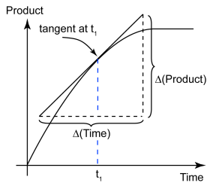
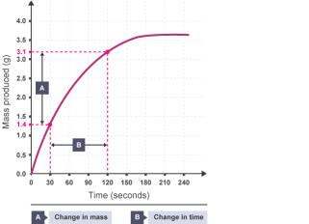
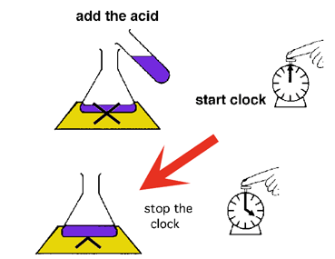
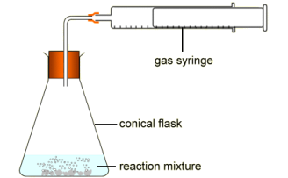
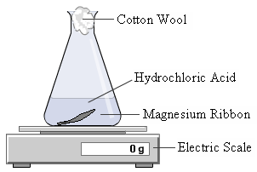
Chemistry Knowledge Organiser Topic 15: Rates of Reaction
Key Terms | Definitions
Rate of Reaction | The rate at which reactants are being turned into products
Reactant | What is used in a chemical reaction
Product | What is made in a chemical reaction
Catalyst | A substance which speeds up a chemical reaction without being used up
Tangent | A straight line that touches a curve at a point
Rate of Reaction
The rate of reaction is the speed at which a chemical reaction is happening. This can vary hugely from reaction to reaction.
The rate of reaction can be calculated either by measuring the quantity of reactant used or the quantity of product made in a certain length of time. The quantity can either be a volume measured in cm³ , a mass measure in grams (g) or an amount measured in Moles (Mol).
Measuring Rate of Reaction-Higher Tier
The gradient of a volume or mass/time graph will give you the rate of reaction at a given point. However when the line is a curve you need to draw a tangent to measure the gradient. To draw a tangent follow the following steps
Line you ruler up across your graph, so that it touches the line on the point that you want to find out the gradient
Adjust the ruler until the space between the ruler and the curve is equal on both sides
Draw the line and pick two easy pints that will allow you to calculate the gradient of the line.
Equation | Meanings of terms in equation
* Rate of Reaction$= \frac{Reactant used}{time}$ | Reactant used can either be measured in Moles, grams or cm³ depending on whether it is a solid or gaseous reactant
* Rate of Reaction$= \frac{Product Made}{time}$ | Reactant used can either be measured in Moles, grams or cm³ depending on whether it is a solid or gaseous product
Measuring the Rate of Reaction
There are several experiments that can be used to measure the rate of a chemical reaction.
Measuring the mass lost in a chemical reaction (marble chips and acid is a good example)
Measuring the volume of gas produced (decomposition of hydrogen peroxide is a good example)
Time taken to make an X disappear, due to formation of a precipitate (sodium thiosulphate and acid is a good example)
Calculating the Mean Rate of Reaction -Higher Tier
To calculate the mean rate of reaction from a graph you need to pick two y values on the graph and two x values, subtract the largest from the smallest and the divide the value on the y axis by the valued on the x axis.

Slide 16
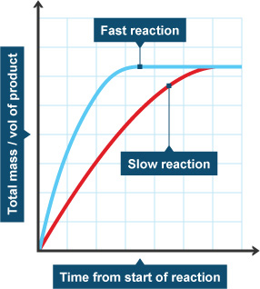
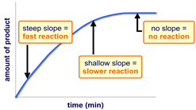
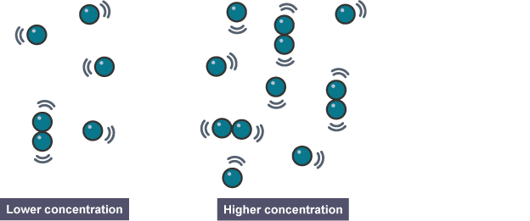
Chemistry Knowledge Organiser Topic 15: Rates of Reaction
Key Terms | Definitions
Activation Energy | The minimum energy required for a chemical reaction to take place
Collision Theory | The theory that states for a chemical reaction to happen, particles must collide with sufficient energy
Gradient | The measurement of how steep a line is on a graph
Frequency | The amount of times something happens in one second
Concentration | The number of particles in a given volume
Interpreting Rate of Reaction Graphs
The results from rate of reaction experiments can be plotted on a line graph. For example how the mass changes against time or how much gas is made against time. Different lines can be plotted for different conditions, the steeper the gradient, the faster the reaction.
It is important to remember that the graphs flatten off (plateau) at the same point as the same amount of reactant is being used.
Factors which affect Rate of Reaction
Being able to slow down and speed up chemical reactions is important in everyday life and in industry. We can change the rate of a reaction by:
· Changing temperature
· Changing pressure (gaseous reactions)
· Changing the concentration of a solution
· Changing the surface area
· Adding a catalyst
Collision Theory
Collision Theory: reactions occur when particles collide with a certain amount of energy.
The minimum amount of energy needed for the particles to react is called the activation energy, which is different for each reaction.
The rate of a reaction depends on two things:
· the frequency of collisions between particles. The more often particles collide, the more likely they are to react.
· the energy with which particles collide. If particles collide with less energy than the activation energy, they will not react.
Collision Theory- in more detail Concentration
If the concentration of a solution is increased then there are more particles in a given volume, therefore collisions are more frequent and the chemical reaction is faster. Concentration is directly proportional to rate of reaction ( if you double the concentration you double the rate

Slide 17
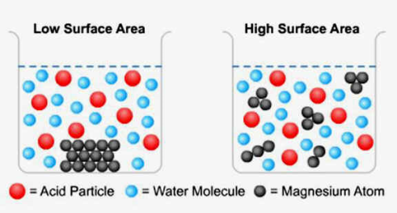
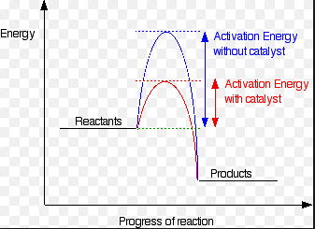
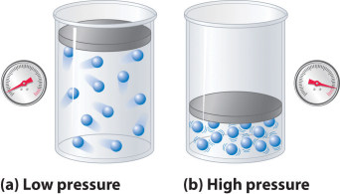
Chemistry Knowledge Organiser Topic 15: Rates of Reaction
Key Terms | Definitions
Enzymes | A biological catalyst
Reaction Profile | A graph which show the energies of the reactants and products at different stages of the chemical reaction
Collision Theory in more detail Temperature
When you increase the temperature of something the particles will move around faster, this increases the frequency of the collisions. As well as that, as the particles are moving faster the particles collide with more energy making it more likely that collisions exceed the activation energy.
Collision Theory in more detail Catalysts
A catalyst is a substance which speeds up a chemical reaction without being used up. It speeds up a reaction because it lowers the activation energy by providing an alternative pathway and this means that there are more successful collisions and a faster reaction.
The effect of a catalyst is shown on the reaction profile below:
Catalysts are not included in a chemical equation as they are not used up in a chemical reaction.
Collision Theory in more detail Surface Area
When you increase the surface area of a solid (you cannot increase the surface area of a liquid or gas). You increase the number of particles that are available for collision, therefore increasing the frequency of collisions therefore increase the rate of reaction.
Collision Theory- in more detail gas pressure
If the reaction is carried out in the gaseous state, then increasing the pressure will increase the rate of reaction. If there are more particles in a given volume of gas, then collisions will be more frequent and therefore the reaction will be faster.
Enzymes
Enzymes are biological catalysts, they speed up chemical reactions in biological systems for example in digestion in animals. Unlike catalysts enzymes have an optimum temperature where they work best, this is usually around 37

Slide 18
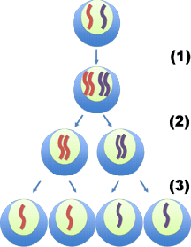
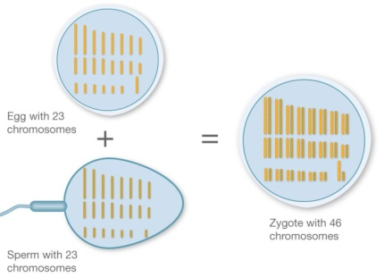
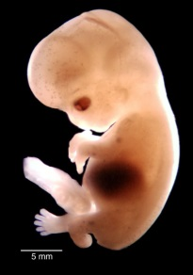
Biology Knowledge Organiser Topic 16: How and Why do Organisms Reproduce?
Key Terms | Definitions
Reproduction | Making offspring. All organisms reproduce.
Offspring | Offspring is a generic term for children – it applies to any type of organism.
Gametes | Sex cells, such as pollen, egg cells, sperm cells. Gametes are produced by meiosis.
Meiosis | Type of cell division that produces gametes. Gametes are genetically unique (compare to mitosis, where genetically identical daughter cells are produced).
Fusion | The joining/fusing of sex cells in sexual reproduction.
Differentiation | The process of becoming a specialised cell. Specialised cells are the result of differentiation of stem cells.
Types of reproduction
Organisms can reproduce sexually or asexually.
Sexual reproduction involves two parents and produces genetically unique offspring. Each parent produces a sex cell (gamete), which fuse as part of sexual reproduction. This means that each parent contributes 50% of the genetic information to the offspring, and the offspring is genetically unique.
Asexual reproduction involves only one parent and there is no fusion of gametes. As a result, there is no mixing of genetic information and the offspring are genetically identical to the parent (they are clones of their parent). No meiosis takes place (since there are no gametes); only mitosis is involved.
Meiosis
You already know how mitosis is used to replace cells in the body. Meiosis is the other form of cell division, but quite different. Meiosis produces gametes, so it happens in reproductive organs (e.g. sperm cells are produced by meiosis in the testes; egg cells are produced by meiosis in the ovaries).
DNA in the nucleus of cells is arranged into structures called chromosomes. In all body cells, the chromosomes appear in pairs (in humans, there are 23 pairs, so 46 chromosomes altogether). However, in gametes, there are half the number of chromosomes of body cells, since they contain one from each chromosome pair (in humans, this means that gametes contain 23 chromosomes).
In meiosis, the DNA is replicated to start with (just like mitosis – step 1 in diagram). But then the cell divides twice – i.e. divides into four cells – so each cell ends up with half the genetic information: a single set of chromosomes. At stage 2 – the pairs are split up, then at stage 3 the copies of chromosomes are separated. The four cells produced are gametes, and all of them are different to each other – they are genetically unique.
Fertilisation
Obviously, fertilisation only happens in sexual reproduction. The male and female gametes fuse. Their nuclei join together into one and the genetic information is combined. Consequently, you have 50% of your genetic information from your mother and 50% from your father. The cell that is produced has the full set of chromosomes (in pairs again) – the normal number is restored. Again, this is 46 chromosomes (23 pairs) in humans. The diagram shows this.
The new cell is ready to grow into an embryo. It does this through mitosis, increasing the number of cells. To be precise, each cell divides to make two cells. This means that a young embryo doubles the number of cells each ‘round’ of mitosis. After a ball of cells is produced, the cells start to differentiate – become specialised. So you are no longer just a blob.
Fertilisation – gametes fuse
Mitosis continues, and many cells differentiate
Cell division by mitosis

Slide 19
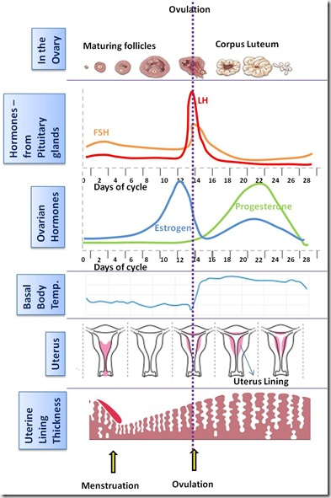
Biology Knowledge Organiser Topic 16: How and Why do Organisms Reproduce?
Key Terms | Definitions
Reproductive hormones | Those hormones that control reproduction. Important examples: testosterone (in males); oestrogen and progesterone (in females).
FSH | Follicle Stimulating Hormone. This is released by the pituitary gland and causes maturation of an egg in the ovary.
LH | Luteinising Hormone. This is released by the pituitary gland and it causes release of a mature egg (ovulation).
Uterus lining | The inside of the wall of the uterus. This is where an embryo implants when it is only a few cells in size.
Maturation | Becoming mature. All a woman’s eggs are in her ovary when she is born, but they must mature before they are released.
Hormones and Human Reproduction
Hormones, those chemical messengers that travel in the bloodstream, control many aspects of reproduction, including the menstrual cycle, which is essential for sexual reproduction in humans (and other animals).
During puberty the reproductive hormones (see key terms) cause the development of secondary sex characteristics. These are the distinctive features of men and women that develop during puberty (e.g. beards and breasts).
Testosterone is the main male reproductive hormone. It is produced in the testes and it stimulates sperm production (sperm cells are also produced in the testes).
Oestrogen is produced in the ovaries (in women), largely responsible for bringing about changes at puberty.
The menstrual cycle is not only the period, although this is where is usually considered to start. The average length of a menstrual cycle is 28 days. The whole purpose of the menstrual cycle is to ready the body for pregnancy, by:
Shedding (releasing) the uterus lining from the previous cycle – causing the period (aka menstruation)
Allowing an egg to mature in the ovary (this is stimulated by the hormone FSH).
Thickening and maintaining the uterus lining in preparation for pregnancy (this is controlled by oestrogen and progesterone).
Releasing an egg (ovulation), about two weeks after the period started (this is stimulated by the hormone LH).
HT: Interactions of hormones in the menstrual cycle
The four hormones involved in the menstrual cycle affect each other. Key points:
FSH stimulates the released of oestrogen
High levels of oestrogen stimulate the release of LH
High levels of oestrogen inhibit (reduce) the production of FSH
Progesterone inhibits the production of both LH and FSH
The changing hormone levels throughout the cycle can be graphed as shown – make sure you are familiar with the sequence and changing hormone levels.
Contraception – preventing pregnancy
One class of contraceptive methods is hormonal contraception. Oral contraceptives (“the pill”) contain hormones to inhibit FSH production so no eggs mature. Injections, implants of hormone-releasing devices, or skin patches can be used for slow-release progesterone, which inhibits the maturation and release of eggs for months or even years.
Non-hormonal methods include:
Barrier methods, like condoms or diaphragms. These prevent sperm reaching the egg.
Intrauterine devices (in the uterus) that prevent any embryos produced from implanting in the uterus. They may also release progesterone, like the hormonal methods above.
Spermicidal agents – chemicals that kill or disable sperm. These are not very effective!
Abstinence – obviously, there will be no pregnancy without sex. An ineffective method of contraception is attempting to time abstinence so you don’t have sex while an egg is in the oviduct.
Sterilisation with surgery: for men, this involves cutting and tying the sperm ducts so no sperm are included in the ejaculate. For women, the procedure is more invasive, involving cutting and tying the oviducts so no eggs reach the uterus, and no sperm can get to them.

Slide 20
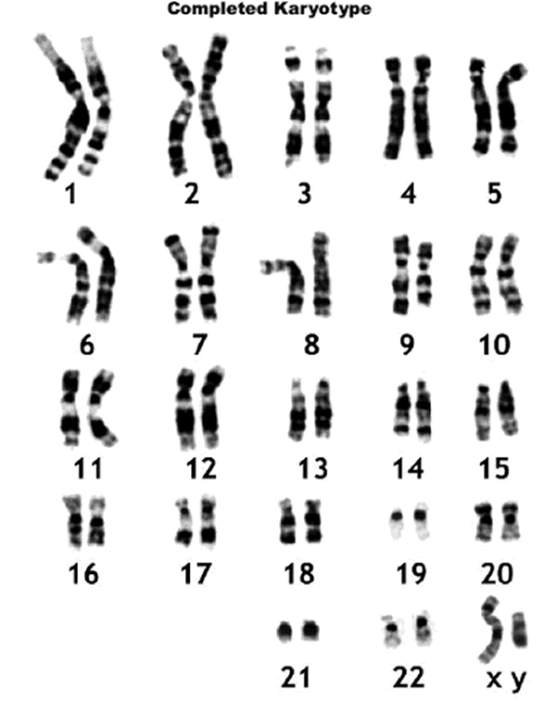
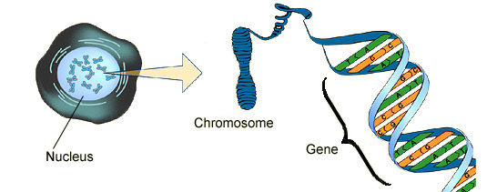
Biology Knowledge Organiser Topic 16: How and Why do Organisms Reproduce?
Key Terms | Definitions
Infertility | Problems conceiving (getting pregnant). Treatments for female infertility given left (HT only).
IVF | In Vitro Fertilisation. This means ‘in glass’ fertilisation – meaning fertilisation happens in a lab.
DNA | The chemical that makes up the genetic material in all cells. DNA is a polymer and arranged as a double helix.
Chromosome | Structure in cells containing one molecule of DNA. Body cells contain two copies of each chromosome – one from each parent.
Genome | The entire genetic material of an organism.
Gene | A section of DNA. Each gene is a code for a sequence of amino acids, so each gene codes for a specific protein.
HT: Hormones to treat infertility
Hormones can be used not only to prevent pregnancy, but to improve the chances of getting pregnant in cases of infertility. Fertility drugs contain FSH and LH, which may help a woman to get pregnant, as the cause of infertility may be low levels of these hormones. Failing this, In Vitro Fertilisation (IVF) can be used. Here’s how it works:
The mother is given FSH by injection to stimulate eggs to mature – a high dose is given so many eggs mature. LH is also given, getting eggs ready for ovulation.
Once eggs have had time to mature and are ready for ovulation, but before they actually get released into the oviduct, they are collected from the ovaries.
In a lab (‘in glass’ – a Petri dish: this is what in vitro means), the eggs are fertilised by sperm from the father. The mother can use a sperm donor at this point.
Still in the lab, in a Petri dish, these fertilised eggs grow into embryos of a few cells.
As tiny balls of cells, ready for implantation, one or two embryos are inserted into the mother’s uterus. They used to insert more than this, to increase the chances of pregnancy, but as effectiveness increased the number of multiple births (twins, triplets etc.) increased, which are a bit more risky than pregnancies with one baby.
So, IVF has allowed many people to have children who couldn’t otherwise. It is stressful though – physically uncomfortable and emotional, because it still only works far less than half of the time. Also, the success rate drops with age. As mentioned, multiple births are more likely in IVF, and these are more risky to mother and baby.
The genome
The genome is the word to describe all the genetic material of an organism. The human genome has been fully sequenced, so we know exactly the order of genes on each chromosome. (Note: in genetic terms, humans are extremely similar so we do have a general human genome. Everyone will vary slightly from it, but by less than 1%.) The micrograph shows the 23 pairs of chromosomes found in human cells, where pair 23 is the sex chromosomes (XY in this person).
Understanding the human genome is very
useful for all sorts of reasons, including:
Helping the search for genes linked to
specific diseases
Understanding inherited disorders (more
on these later)
Using the tiny differences in genetic
information between people to track how
humans have migrated all over the planet.
DNA
DNA is a chemical, a compound made of elements you know – carbon, hydrogen, nitrogen, oxygen, phosphorus. It is a polymer – meaning a very long molecule with units that repeat over and over. Each molecule of DNA is in fact made of two strands that run opposite one another and join in the middle (see diagram). These two strands form a spiral we call a double helix – double because there are two strands, and helix is just another word for spiral.
DNA is contained in chromosomes, where each chromosome contains one molecule of DNA – one long double helix each (there are also protein molecules as part of chromosomes). Short (compared to the whole molecule) sections of DNA called genes code for proteins (see diagram). This is how DNA gives you characteristics – the genes inherited from the parents, on the chromosomes they pass on to you, code for the sequence of amino acids to make specific proteins.

Slide 21
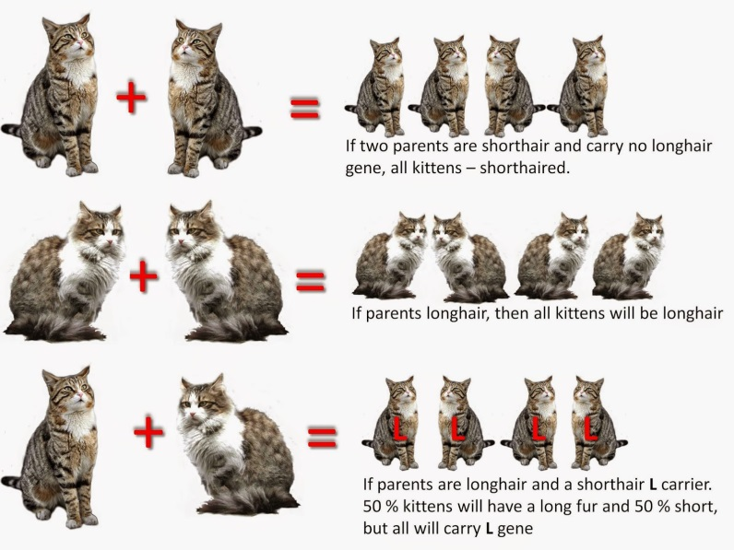
Biology Knowledge Organiser Topic 16: How and Why do Organisms Reproduce?
Key Terms | Definitions
Allele | A form or version of a gene. Since you inherit a copy of each chromosome from each parent, you have two copies of each gene – we call these two versions alleles.
Express | In genetics, to ‘express’ a gene means for it to be used by the body to make a protein, causing a characteristic.
Dominant | Describes alleles that are always expressed (so you see the effects in the organism). Indicated with a capital letter to represent the allele e.g. D.
Recessive | Describes alleles that are only expressed if there are two recessive copies (one from each parent). In other words, recessive alleles are only expressed if there is no dominant allele present. Indicated with a lower case letter to represent the allele e.g. d.
Genotype | The combination of alleles that an individual has. Often represented with two letters: e.g. DD, Dd or dd.
Phenotype | The physical characteristic that results from a particular genotype.
Homozygous | Describes a genotype where both alleles are the same – e.g. DD is homozygous dominant; dd is homozygous recessive.
Heterozygous | Describes a genotype where the two alleles are different (one dominant, one recessive) – e.g. Dd.
Genetic inheritance
All the genes you have, you inherited from your parents. They gave you half your genome each. Since they gave you one from each pair of chromosomes you have now, they in fact gave you one copy of each gene each – i.e. genes for the same thing. We call the two different versions of each gene alleles. Some characteristics are controlled by one gene – or rather, the two alleles of a single gene. E.g. fur colour in mice, red-green colour blindness in humans. However, most characteristics come about thanks to many genes and their interactions, not just one gene.
The alleles present in an individual organism cause body cells to produce certain proteins, or versions of proteins (as this is what a gene does remember). This is called expression of a gene, and leads to physical characteristics we call phenotypes.
This is easier with an example. Look at the cats below: the allele for short fur in cats is dominant to the allele for long fur. Let’s call the alleles F and f respectively. In the top example, both parents are homozygous dominant (genotype: FF). This means all the gametes they produce will have one F in them, so at fertilisation the only possibility is for the offspring to get FF. So all their offspring have the short fur phenotype.
In the second row, both parents have long hair, so they must both have the genotype ff (homozygous recessive). Consequently, all their offspring must have long hair too.
In the third row, the first parent has short hair but is heterozygous (genotype: Ff) – so they still have short hair as the short hair allele is dominant. If they mate with a long hair cat (genotype ff), there are different probabilities for offspring phenotypes, as they will get either F or f from the first parent. So, half of them will have short hair (with genotype Ff) and half will have long hair (with genotype ff).
Probability and ratios
Knowing the genotypes of the parents allows you to work out the probability of each genotype (and therefore phenotype) in the offspring. It does not guarantee, like in the bottom cat example, that they’ll have four kittens, or that half will have long hair. What it tells us is: for each kitten, there is a 50% chance of it having long hair.
The other way of saying this is that the expected ratio of offspring genotypes is 1:1 for long:short hair. So if the bottom two cat parents had 50 kittens, we’d expect 25 of each hair length.

Slide 22
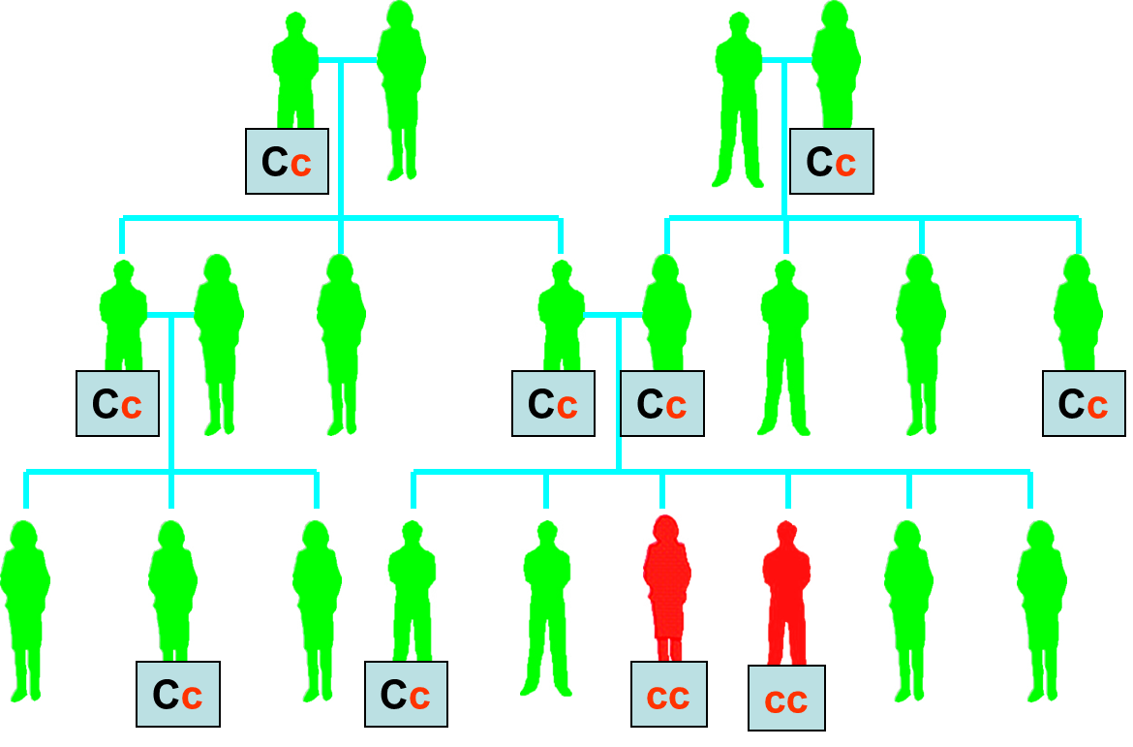
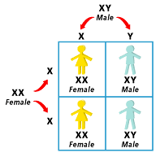
Biology Knowledge Organiser Topic 16: How and Why do Organisms Reproduce?
Key Terms | Definitions
Screening | The practice of checking for a disease or an inherited disorder.
Carrier | An individual with one copy of the recessive allele that causes an inherited disorder (e.g. Cc for the cystic fibrosis genotype). As a result, they don’t have the disorder, but they can pass one allele for it onto their offspring.
Sex chromosomes | Pair 23 in humans. Females have the combination XX, males have the combination XY.
Genetic cross | An unglamorous term given to mating between two individuals, producing offspring.
Punnett square | A tool used to predict the outcome of a genetic cross.
Inherited disorders
Some disorders (or diseases – same thing really) are inherited, so we can also call them genetic disorders. If someone inherits a certain allele/combination of alleles, they have the inherited disorder. Two examples to know:
Polydactyly: a condition where people have extra fingers or toes. This is caused by a dominant allele, so only one copy is needed to have the condition.
Cystic fibrosis: a condition where protein pumps in cell membranes don’t work properly, leading to thick and sticky mucus being produced in the lungs and intestines. This is caused by a recessive allele, so individuals with cystic fibrosis are all homozygous recessive.
Studying family trees can help genetic scientists decide whether a disorder is caused by a recessive or dominant allele. In the family tree shown, C is the allele for healthy cell membranes, and c is the allele for disordered cell membranes. Both parents must have at least one c to have children with cystic fibrosis, as the family tree shows. (Note: anyone without a genotype shown has the genotype CC).
Since we know which alleles cause conditions like these, unborn babies, or embryos produced during IVF, can be checked – or screened – to see if they have the inherited disorder. This practice, embryo screening, can be used to inform whether an embryo should be implanted in IVF, or, if used during pregnancy, to decide whether an abortion should take place. Obviously, these are huge decisions and the right to life of the embryo must be weighed against the difficulties they’ll face with an inherited condition and the personal choice and beliefs of the parents.
Sex determination
In biology, sex is not short for sexual intercourse. Sex means male or female – so is only relevant to organisms that reproduce sexually. The sex of offspring is determined by the combination of sex chromosomes inherited from the parents. Of the 23 pairs of chromosomes all humans have, 22 control body characteristics and the 23rd pair determines sex. [Note: like all chromosomes, the sex chromosomes carry genes, they just have the extra function of sex determination.] Human females have the combination for pair 23: XX. We say they have two X chromosomes. Human males have the combination XY for pair 23 (they are different).
When having children, then, mothers always pass on one X chromosome to their offspring. Males can pass on an X chromosome OR a Y chromosome – there’s a 50:50 chance of each. This is because, when cells divide by meiosis to make gametes, all the female gametes contain an X, but half the sperm cells have an X, half have a Y. How these combine to give a 50% chance of a girl is shown in the Punnett square to the right.
On the top, the possible male gametes are placed.
On the side, the possible female gametes are placed.
The possible combinations are shown. The ratio of female:male is 2:2, simplifying to 1:1.

Slide 23
Biology Knowledge Organiser Topic 16: How and Why do Organisms Reproduce?
Key Terms | Definitions
Variation | Differences in the characteristics of individuals in a population.
Genetic variation | Differences in the genome between individuals. This often causes differences in physical characteristics.
Variants | Different versions of the same thing. Often this term is used to describe individuals who are different from others in a specific genetic way – for instance the ‘long haired cat variant’ from earlier.
Mutation | A change to DNA. Mutations can cause a change in the sequence of amino acids being produced, affecting the protein being produced from the DNA code.
Evolution | Change in the inherited characteristics of organisms over time. Evolution happens through natural selection.
Natural selection | The process that changes the inherited characteristics of organisms over time. This explains the adaptations of organisms to their environment AND the formation of new species of organism.
Common ancestor | An ancestor in common. For instance, if you have a sister, your granddad is a common ancestor to you both.
Variation
Organisms vary, both organisms of different species (obviously) and organisms of the same species (also obviously!). Variation (differences) are caused by both genetic causes and environmental causes.
Some differences are only due to inherited genes – they are entirely genetic;
Some differences are only due to the conditions in which an organism developed and lives – they are entirely environmental;
Some differences are due to a combination of genetic and environmental influences. In this case, we say the genome of an organism and its environment interact to affect the phenotype of the organism.
In most populations of most species of organism, there is a lot of genetic variation. The general term for versions of the same organism (i.e. different individuals of a species) is with different genetic information is variants. All variants arise from mutations. Mutations can be dangerous (remember your work on cancer, for instance), but usually have no effect. Sometimes, they have a beneficial effect. Overall:
Mutations happen continuously;
most mutations will not affect the phenotype at all;
some will influence the phenotype (maybe change it a bit);
very few mutations cause a total change in phenotype.
The last case is rare, but very important. If a mutation occurs that leads to a new phenotype, and the new phenotype makes the organism better suited to the environment, it will lead to a rather rapid change in the species, by natural selection.
New species
The theory of evolution by natural selection tells us that all species of living things have evolved from a single, simple type of life form. We know this common ancestor was alive on Earth over three billion years ago. How we ended up with millions of different species from this single species is also explained by evolution by natural selection.
Essentially, two populations of one species (e.g. a population of fish is divided into two populations by geographical changes such as the joining of North and South America) can become two different species. This happens when the two populations become so different in their phenotypes that they can no longer interbreed to produce fertile offspring. This is the point when we define them as different species. For example, tigers and lions are different species (the population of their common ancestor has been separated for a long time) – they can interbreed (producing a liger), but ligers are infertile. So their parents are different species.
Evolution
Evolution is the change in inherited (genetic) characteristics of organisms over time. Many theories of evolution have been suggested, but Darwin’s theory of natural selection is the one with by far the most evidence. Darwin noticed that all organisms produce more offspring than they need to replace themselves, and yet population sizes stay pretty steady from generation to generation. He also observed that all species show variation, and that life is tough for organisms – only the best adapted survive. So, based on these observations, we can explain evolution by natural selection like this:
A population of organisms shows variation – there are variants in the population
The organisms are in competition to survive
Survival of the fittest – only the variants with the phenotypes best suited to the environment get to survive
Reproduction – those who survive get to reproduce
Genetic inheritance – their offspring inherit the genes from their parents, so the successful phenotype becomes more common in the next generation. This continues from generation to generation.

Slide 24
Biology Knowledge Organiser Topic 16: How and Why do Organisms Reproduce?
Key Terms | Definitions
Fossil | The remains of organisms from millions of years ago, found in rocks. They are formed in different ways – see main text.
Strain | A variant of microorganism within a species – so they are not a different species to other variants, but have a key difference in their phenotype (e.g. being resistant to an antibiotic). New strains are produced by mutations.
Resistant strain | Describes a variant form of bacteria with resistance (NOT immunity) to a specific antibiotic.
MRSA | An example of a resistant strain of bacteria. It stands for methicillin resistant Staphylococcus aureus.
Extinction | When NO individuals of a species remain alive.
Evolutionary tree | A timeline that shows how closely related different species are to each other.
Evidence for evolution
There is a vast haul of evidence to support Darwin’s theory of evolution by natural selection. This evidence has built up over time: for example, Darwin didn’t know about genes so found it hard to explain inheritance from parents in full. Obviously, we’ve got this knowledge now.
Thanks to all this evidence, Darwin’s theory for evolution is now very widely accepted. Two key bodies of evidence for you to know are: the fossil record, and the evolution of resistant bacteria.
Fossils
Fossils are the remains of organisms. They are always old, typically millions of years old, and are found in rocks. They can form by:
The organism or parts of the organism don’t decay because the conditions are not right for decay by microorganisms. For example, mammoths have been preserved in frozen mud.
Parts of the organism are replaced by minerals from the surrounding rocks as they decay. Most often, this results in soft tissues (e.g. muscle, skin) decaying normally, but the form of bones is preserved by the minerals in bones being swapped for minerals from the rocks/sediments that the dead organisms were buried under.
Preserved traces of organisms – so not their actual bodies, but traces like footprints, droppings, burrows and the traces of roots.
As most fossils are formed from bones, and many early forms of life had soft bodies (no bones), there are few traces of early forms of life. Any traces there were tend to have been destroyed by geological activity (movements of tectonic plates, volcanic activity and so on). This means the fossil record is incomplete and scientists cannot be totally sure about the origin of life on Earth.
The fossil record helps scientists fill in timelines and evolutionary trees to show how life has changed over time on Earth. Using evolutionary trees shows the closeness of relationships between different species.
Resistant bacteria
The key factor that affects the rate of evolution is how fast an organism reproduces. Bacteria can reproduce as fast as doubling every 20 minutes, so they can evolve rapidly.
Thanks to a mutation, strains of bacteria that are resistant to an antibiotic can emerge. These are NOT killed by antibiotics used to try to kill them when the bacteria has infected someone. Consequently, they survive and reproduce, so the size of the resistant strain population increases generation to generation, while the non-resistant strain is wiped out. Furthermore, the resistant strain is likely to spread because if it infects other people and:
They are not immune to it
And there is no effective treatment.
Society benefits if we reduce the rate of development of antibiotic resistant strains of bacteria. Some methods to help save the day:
Antibiotics should not be prescribed by doctors where they are not needed (especially for viral infections, since antibiotics don’t work on viruses).
Patients need to finish the full course of antibiotics they get prescribed, reducing the chance of any surviving and mutating to form resistant strains.
Restrict the use of antibiotics in agriculture, as at present many animals receive antibiotics all the time to prevent infections and encourage growth.
We also badly need new antibiotics. However, it is slow and expensive to develop new antibiotic drugs, and at the moment we are not keeping up with the emergence of resistant strains of bacteria.
Extinction
Extinctions of a species can happen for many reasons, and often extinction is due to more than one factor working together. Some key factors that may contribute to extinction of a species:
Development of new species, so the old species doesn’t exist any more
New diseases affecting a species, which they aren’t adapted to and can’t survive
New predators, to which a species cannot adapt fast enough to survive
Changes to the environment, to which the species cannot adapt by natural selection, including catastrophic events (like the meteor strike that caused extinction of loads of species, e.g. dinosaurs)
New competitors that are better adapted to the environment than the species.

Slide 25
Biology Knowledge Organiser Topic 16: How and Why do Organisms Reproduce?
Key Terms | Definitions
Selective breeding | Also known as artificial selection. A technique of improving domesticated animals and plants for humans benefit, by breeding for particular genetic characteristics.
Domesticated | Animals/plants used in agriculture (or for pets!) are called domesticated species.
Inbreeding | The result of selective breeding can be inbreeding, where limited genetic variation can make organisms more prone to disease or inherited defects.
Genetic engineering | Modifying the genome of an organism by introducing a gene from another organism, giving a desired characteristic.
Genetically modified | GM for short. Describes organisms (especially crops) that have had their genome modified by genetic engineering.
Yield | The amount of useful product you get from a plant or animal used in agriculture (e.g. mass of fruit).
Vector (HT) | In the context of genetic engineering, a vector is a piece of genetic material used to transfer a gene. It is usually a bacterial plasmid or virus.
Selective breeding
In selective breeding, domesticated animals or plants are bred for particular genetic characteristics. This is not a new thing: humans have been choosing which animals/plants to breed together ever since agriculture was invented many thousands of years ago. The organisms with desired characteristics are chosen and deliberately bred together – if all goes well, the offspring have inherited the desired characteristics. The offspring with those characteristics are then bred together, and so on for many generations until all the offspring have the desired characteristic. Some examples of characteristics that selective breeding is used to obtain:
Disease resistance in food crops
Animals which produce more e.g. milk or meat
Domestic (pet) dogs with gentle natures, high intelligence and so on
Large or unusual flowers.
So, selective breeding is very useful. However, because of the deliberate selection of organisms with certain genetic characteristics for breeding, inbreeding can result from its use.
Genetic engineering
Genetic engineering is common and extremely useful. Recall that one gene codes for one protein, which in turn leads to specific characteristic. If an organism has the gene for a characteristic you want, you can transfer that gene into the genome of a different organism altogether. This has allowed, for example, the genetic engineering of plant crops to make them resistant to disease or to produce bigger, better fruit. Another key example is the genetic engineering of bacteria so they produce human insulin for treatment of type 1 diabetes.
How genetic engineering works:
Genes from an organism with a desired characteristic are ‘cut out’ of their genome and transferred to the cells of other organisms, in such as way that the second organism uses the gene from the first one. The resulting organism is called a genetically modified organism.
Good examples of GM crops include those that are now resistant to attack by insects, or are not affected by the herbicides that farmers use to kill weeds (obviously, it would be bad news to use a herbicide that kills your weeds but also your crops). GM crops are also often produced to have higher yields.
Genetic engineering – the controversy
There are some concerns about GM crops. The most important include concerns about how the GM crops may effect wild flowers and insects. There is not thought to be any risk to human health eating them, but some people call for more research on this.
Research is going on into how genetic modification might be used to overcome inherited disorders in humans.
HT: Genetic engineering – the steps
The summary is given left. The steps in more detail:
Enzymes are used to cut out, or isolate, the required gene.
This gene is placed in a vector, so it can be transferred to the organism you intend to genetically modify.
The vector is used to insert the gene into cells of the second organism (e.g. the food crop). This has to be done at an early stage of development (i.e. as a tiny embryo) so the organism develops with the desired characteristic.
[It wouldn’t be much help to add the gene to an adult, since you’d have to add it to every cell to give them the desired characteristic.]

Slide 26
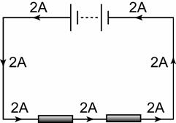
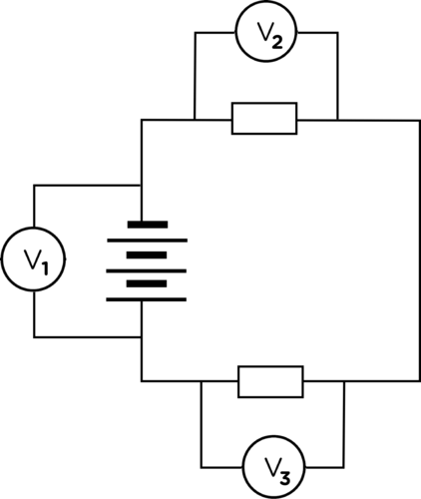
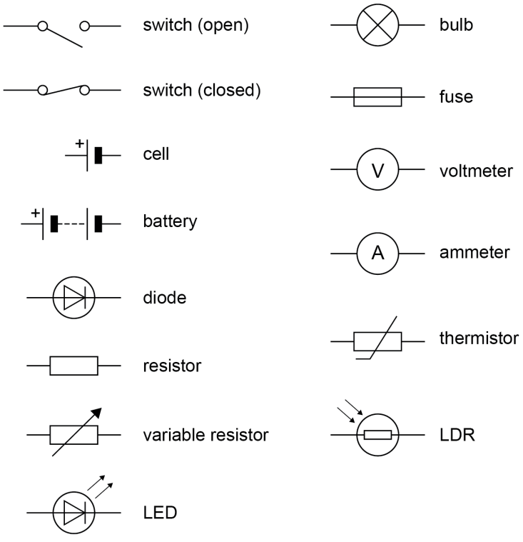
Physics Knowledge Organiser Topic 17: Electricity
Key Terms | Definitions
Electric charge | Just a positive or negative charge! In most electrical circuits, the electric charges that are flowing are electrons – which are of course negatively charged. Symbol: Q
Current | The rate of flow of electric charge (i.e. speed). Calculated by dividing the size of the charge by the time. Symbol: $I$
Potential difference | Also known as voltage, or p.d.. The potential difference is a measure of how much work is done per coulomb of charge.
Resistance | Resistance determines the size of the current for a particular potential difference.
Electric charge and current
Every atom contains particles with an electric charge: protons and electrons. By getting electric charges to flow, we can get them to do work (i.e. transfer energy) in all sorts of useful ways. For that is what happens in any electric circuit you can think of: flowing charges transfer energy.
If we want to get electric charges to flow, we must make a closed, or complete circuit – a loop of conducting materials, like metal wires. Then, we must provide a source of potential difference. The source of potential difference could be a cell, battery or the mains. What these sources do is to create a difference in electrical potential energy – hence the name. This provides the force to make the electric charges in the conductors flow. When electric charges, like electrons, are flowing, we call it an electric current.
The size of an electric current is simply the rate of flow of electric charge.
So current ($I$) = $\frac{Q}{t}$ or $Q=It$
In a circuit, in any closed loop of the circuit, the size of the current is the
same throughout the loop. As shown on the diagram, the current is the
same in all parts of the loop, including through the battery and through
the resistors.
Equation | Meanings of terms in equation
$$Q=I t$$ * | Q = charge flow (coulombs, C) I = current (amperes, A) t = time (seconds, s)
$$V=I R$$ * | V = potential difference (volts, V) I = current (amperes, A) R = resistance (ohms, Ω)
Current, resistance and potential difference
Cells and batteries etc. are sources of potential difference. This means they boost the potential energy of charges in a circuit. Other components, like resistors or bulbs, do work – so they take the potential energy of the charges and transfer it into some other form, like light or heat. In a circuit, all the energy provided by the cell/battery is transferred by the components in the circuit all together. So, in components like bulbs, the charges do work – i.e. they transfer energy. By definition, this means they have a potential difference across them. We say ‘across’ since it is a difference, from one side of the component to the other.
The current through a component depends on this potential difference across the component, but also its resistance. Without any resistance, a component would do no work (try putting a 0 in the equation!), so things like bulbs HAVE TO have resistance. The resistance of a component, along with the potential difference across it, determines the current through it, as shown in the second equation. It shows us that: if we keep the potential difference the same, but increase the resistance, the current must decrease. If we keep the potential difference the same, but decrease the resistance, the current must increase.
Look how the voltmeters are added across the components to measure the potential difference across them.
Yes, you need to learn these symbols.

Slide 27
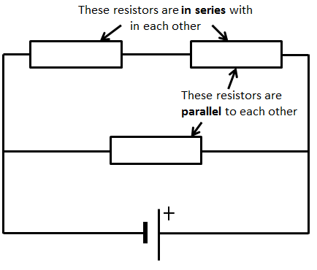
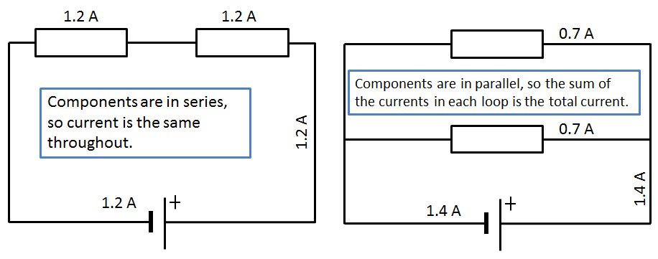
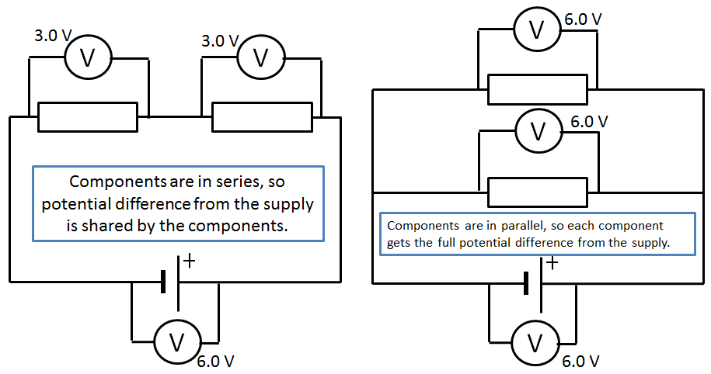
Physics Knowledge Organiser Topic 17: Electricity
Key Terms | Definitions
Series | Components connected one after another in a closed loop.
Parallel | Components connected in different loops of a circuit.
Resistor | An electrical component that regulates current in a circuit. Bear in mind, all electrical components have resistance, so are resistors in some sense, as well as being e.g. bulbs.
Series and parallel circuits
We can connect components in a circuit in series or in parallel. In some circuits, there are components in series AND components in parallel – see the example in the diagram.
The quantities of resistance, current and potential difference behave differently in components connected in series compared to components connected in parallel. Study the table and diagrams carefully.
Equation | Meanings of terms in equation
for series circuits: $$R_{total}= R_{1}+ R_{2}$$ * | $R_{total}=$ total resistance (ohms, Ω) $R_{1}$ = resistance of first component (Ω) $R_{2}$ = resistance of next component (Ω) – and so on
Quantity | Components connected in series… | Components connected in parallel…
Current | The current through each component is identical | Shared between the loops. The total current through the whole circuit is the sum of the currents through each loop of the circuit.
Potential difference | The potential difference provided by the power supply is shared between the components in series (not necessarily equally shared out – it depends on the resistance of each component). | Each loop receives the full potential difference provided by the power supply. If we are dealing with just two components in parallel, the potential difference across each is exactly the same, and exactly the same as the potential difference provided by the power supply.
Resistance | The total resistance of two components is the sum of the resistance of each component (see equation). So, adding more resistors in series increases the total resistance. | The total resistance of two components in parallel is always less than the smallest resistance of the components. As a result, adding more resistors in parallel actually decreases the overall resistance.

Slide 28
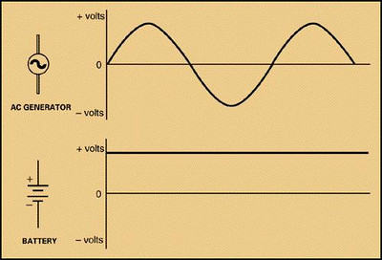
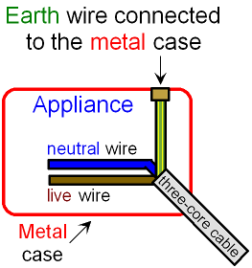
Physics Knowledge Organiser Topic 17: Electricity
Key Terms | Definitions
Direct p.d. | A supply where the potential difference is fixed at a certain value, so the current flows in one direction only
Alternating p.d. | A supply where the p.d. switches between positive a negative, reversing the direction of the current frequently.
Frequency | The number of times the p.d. reverses direction every second. Measured in Hertz (Hz).
Direct and alternating potential difference
The flow of charge (current) in a circuit can travel in one direction around the circuit only. This is due to a direct supply of potential difference, also known as dc. Cells and batteries provide a direct potential difference. However, it is possible for the direction of the current to change back and forth in a circuit. This happens when there the supply provides an alternating potential difference – also known as ac. This means the p.d. is constantly switching from positive to negative, which you can see if you measure the p.d. and produce an image of is on an oscilloscope, as the diagram shows. The rate at which the p.d. switches from positive to negative is called the frequency of the supply. The bottom image, since the supply is a battery, shows a direct potential difference.
The national grid
The national grid connects power stations to consumers of the power – like you. It consists of a network of cables (i.e. power lines) and transformers. There are two types of transformers; together they improve the efficiency of the energy transfer from power station to homes and schools etc.:
Step-up transformers increase the p.d. from the power station to the transmission cables. This reduces the current so less energy is lost as heat.
Step-down transformers decrease the p.d. from the cables to a much lower value (230V, generally) for domestic use. This increases the current to suit electrical appliances used at home.
Mains electricity
Mains electricity (the supply into your house/school etc. that comes through the plugs) is an ac supply. In the UK, we have a supply with a p.d. of about 230V, and the frequency is 50 Hz.
DANGER (and safety)
The earth wire carries current to the ground
(literally, earth). This makes circuits safer
because if there is a fault, it conducts the
current to the ground rather than making
the appliance ‘live’. Appliances become live
if the live wire touches the case. This is
particularly a problem with metal-cased
appliances, like cookers or toasters.
The live wire is the most dangerous one, since it is at 230 V. it should never touch the earth wire (unless the insulation is between them, of course!), because this would make a complete circuit from your mains supply to the ground (earth). A shock or fire would be highly likely.
Even if a circuit is switched off (i.e. the switch is open), the live wire can still be dangerous. If you touch it, you may complete a circuit between the live wire and the earth (because you’ll be standing on the floor), so you get a shock.
Wire in three-core cable | Colour code of the insulation | Function
Live wire | Brown | Carries the alternating p.d. from the supply to the appliance
Neutral wire | Blue | Completes the circuit. The neutral wire is at 0 V (earth potential).
Earth wire | Yellow and green stripes | Earth wires are at 0 V. They are safety wires, and only carry a current if there is a fault and the appliance has become live (electrified).
Three-core cables
We connect most electrical appliances to the mains with a three-core cable. The three pins on a plug are just the three ends, or terminals, of the three wires in the cable. Each wire in insulated in a different colour.
Earth wire
Neutral wire
Live wire

Slide 29
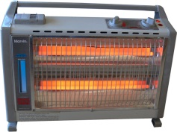
Physics Knowledge Organiser Topic 17: Electricity
Key Terms | Definitions
Power | The rate of energy transfer. In electrical components, the power is found by multiplying p.d. by current.
Work | Transfer of energy.
Appliance | Any device that transfers electrical energy to other forms. The supply of electrical energy can be a cell, battery, or the mains ac supply.
Power
You should recall that power is the rate of energy transfer, or the rate at which work is done. In electrical components, including any electrical appliance, the power relates to the potential difference across the component and the current through it. If either p.d. or current increases, the power increases. In other words, the rate of energy transfer increases. This should be clear from the first equation.
The second equation also finds the power. The equation comes from substituting in V = IR. The second equation is useful if you don’t know the p.d. across a component.
Equation | Meanings of terms in equation
$$P=V I$$ * | P = power (watts, W) V = potential difference (volts, V) I = current (amps, A)
$$P= I^{2} R$$ * | P = power (watts, W) I = current (amps, A) R = resistance (ohms, Ω)
$$E=P t$$ * | E = energy transferred (joules, J) P = power (watts, W) t = time (seconds, s)
$$E=Q V$$ * | E = energy transferred (joules, J) Q = charge flow (coulombs, C) V = potential difference (volts, V)
Energy transfers in electrical appliances
The whole point of electrical appliances is to transfer energy. The electrical potential energy from the supply is transferred to something useful – such as light and sound in your TV. The other way of saying this is that work is done when charge flows in a circuit.
Some examples of energy transfers in electrical appliances:
In your mobile phone, electrical potential energy from the dc supply (the battery) is transferred to light, sound and thermal energy. This means the energy from the battery is dissipated to the surroundings.
A washing machine transfers electrical potential energy from the ac mains supply to kinetic energy in the electric motor (that’s why it spins), along with heat. Eventually, all the energy of the input is dissipated to the surroundings.
An electric heater transfers the electrical potential energy of the supply
to thermal energy. The energy stored in the supply ends up stored in
the air, the walls, the floor and so on around the heater: stored in the
heat of the materials.
The amount of energy transferred by an appliance depends on the power of the appliance and the time it is switched on for. To find the amount of energy transferred, simply multiply the power of the appliance by the time it is on for (see third equation).
Furthermore, since p.d. is a measure of how much work is done per coulomb of charge, you can find out how much work is done (aka energy transferred) by a circuit by multiplying the charge flow by the p.d. (see fourth equation).
High power, low power
The power of an appliance determines how much energy is transfers in a given length of time. If an appliance has a high power (e.g. a washing machine), it transfers lots of energy in a given time. If it has a low power (e.g. a lamp), it doesn’t transfer much energy in a given time, in comparison.
The other way of looking at it is how long the appliance takes to transfer a given amount of energy, e.g. 1000 J. A washing machine will transfer the energy in a very short length of time, whereas a lamp will take much longer to transfer this energy.

Slide 30
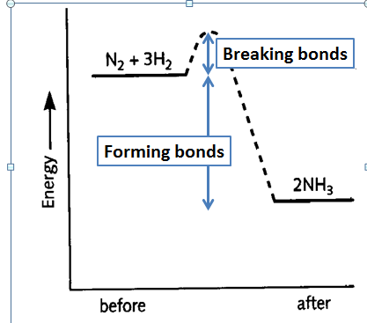
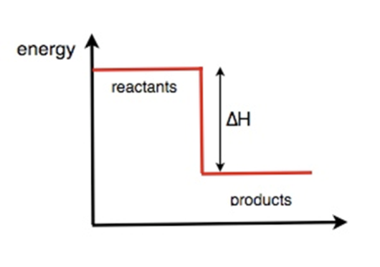
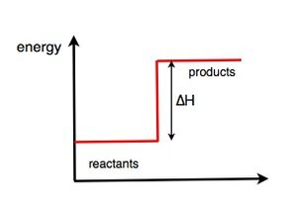
Chemistry Knowledge Organiser Topic 18:Energetics
Key Terms | Definitions
Reaction Profile | A graph which shows the energies of the products and reactants in a chemical reaction
Exothermic | A reaction that gives out heat to the surroundings
Endothermic | A reaction that takes heat in from the surroundings
Energy in Reactions
Energy is conserved in chemical reactions. The amount of energy in the universe at the end of a chemical reaction is the same as before the reaction takes place. In a chemical reaction, bond breaking and bond making occur. To break a chemical bond you need to overcome the force of attraction in the bond, this process requires energy therefore it is endothermic. The process of bond formation is exothermic, energy is released when bonds form. In a chemical reaction the difference between the energy required to break the bonds and the energy gained from making the bonds will decide whether a reaction is exothermic or endothermic.
Chemical reactions can therefore be divided into exothermic and endothermic chemical reactions.
Reaction Profiles- In more detail
The profile below shows the reaction which makes ammonia from nitrogen and hydrogen. The equation is given below:
N₂+3H₂→2 NH₃
There are some key features to highlight on this graph ,firstly the curved section represents the activation energy for this reaction, this hump shows how much energy is required to break the bonds in the reactants. To overcome the activation energy we often need to heat our reactants. The products are lower in energy than the reactants, this means it is an exothermic reaction. As the excess energy is given out to the surroundings. as heat energy.
 | What happens? | Why? | Example
Exothermic | Heat energy is transferred to the surroundings. | The energy required to break chemical bonds is less than the energy gained from making chemical bonds. Therefore the excess is given off as heat to the surroundings. | Combustion reaction, reactions used in hand warmers
Endothermic | Heat energy is taken in from the surroundings | The energy required to break chemical bonds is more than the energy gained from making chemical bonds. Therefore heat is taken in from the surroundings. | The reaction of citric acid and sodium hydrogencarbonate, the reactions used in ice packs
This hump shows the activation energy
Reaction Profiles
Reminder from topic 15: Chemical reactions can occur only when reacting particles collide with each other and with sufficient energy. The minimum amount of energy that particles must have to react is called the activation energy.
Reaction profiles can be used to show the relative energies of reactants and products, the activation energy and the overall energy change of a reaction.
This is the reaction profile of an exothermic reaction, the energy of the products is lower than that of the reactants. The difference in energy is released as heat to the surroundings.
This is the reaction profile of an endothermic reaction, the energy of the products is higher than that of the reactants. The difference in energy is taken in from the surroundings.
Calculating bond energies -higher tier.
The difference between the sum of the energy needed to break bonds in the reactants and the sum of the energy released when bonds in the products are formed is the overall energy change of the reaction.
For example consider the reaction:
N₂+3H₂→2 NH₃
To work out the overall energy change you will need to subtract, the energy gained from forming the bonds in ammonia, from the energy required to break the nitrogen and hydrogen bonds. This will give you the overall energy change, if the value is negative then the reaction is exothermic, if the value is positive the reaction is endothermic

Slide 31
Chemistry Knowledge Organiser Topic 18:Energetics
Key Terms | Definitions
Equilibrium | A reaction that is reversible
Le Chatelier’s principle | A principle which states, “If a system is at equilibrium and a change is made to any of the conditions, then the system responds to counteract the change”
Dynamic Equilibrium | An equilibrium where the forward and backward reactions are happening at the same rate
Bond Energies continued- Higher Tier
You can calculate the energy change in a reaction from bond energies given to you in a question. For example consider the reaction below:
This shows that hydrogen peroxide breaks down to make water and oxygen. We can use bond energies to work out the energy change in the reaction.
The energy required to break the reactant bonds is:
2 x464 (for the O-H bonds) = 928 + 146 (for the O-O bond)=1074 however as there is a 2 in the equation this number needs to be doubled.
2 x 1074 = 2148 klj/mol
The energy gained from making the product bonds is:
2x464= 928 but there is a 2 in the equation so this doubled to 1856 and we also need to add the 498 for the double bond in O₂
1856+498=2354 kj/mol
Therefore we do energy required to break reactant bonds- energy gained from making product bonds:
2184-2354=-170kj/mole
If the value is negative then the reaction is exothermic
If the value is positive the reaction is endothermic.
Equilibrium
Some chemical reactions are reversible, this means they can happen in both the forward and reverse directions. The symbol we use to represent an equilibrium reaction is shown in the equation below:
In a dynamic equilibrium reaction, the forward and reverse reactions are happening at the same rate.
A dynamic equilibrium has to occur in a closed system, where no reactants and products are allowed to escape.
If the equilibrium lies to the left, it means that there is a greater concentration of reactants than products
If the equilibrium lies to the right it means there is a greater concentration of products than reactants.
Most equilibrium reactions are endothermic in one direction and exothermic in another direction. A good example is the hydration and dehydration of copper sulphate. It is exothermic when water is added to the copper sulphate, it is endothermic when water is removed.
Bond | Bond energy in kJ per mole
H – O | 464
O – O | 146
O = O | 498

Slide 32
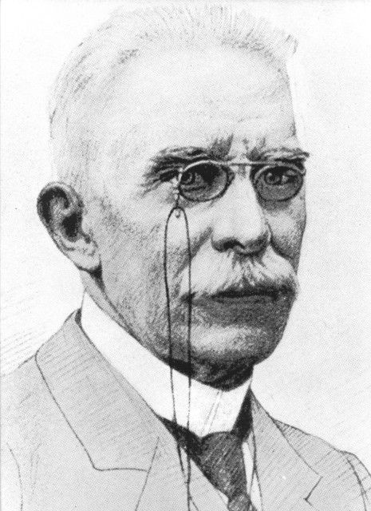
Chemistry Knowledge Organiser Topic 18:Energetics
Key Terms | Definitions
Equilibrium | A reaction that is reversible
Le Chatelier’s principle | A principle which states, “If a system is at equilibrium and a change is made to any of the conditions, then the system responds to counteract the change”
Dynamic Equilibrium | An equilibrium where the forward and backward reactions are happening at the same rate
Changing Conditions-Le Chatelier’s principle- Higher Tier
The Haber process is a good example to explain Le Chatelier’s principle, the equation for the Haber process is shown below. The reaction is carried out in the gaseous state. Remember this is one of many reactions but the principles always stay the same.
Endothermic in this direction
Exothermic in this direction
Equilibrium- Changing Conditions-Higher tier
The amounts of all the reactants and products at equilibrium depend on the conditions of the reaction. For example if we change things like temperature, concentration of a reactant or product and pressure in gases.
The French scientist Le Chatelier devised a principle to explain how equilibrium reactions, respond to a change in conditions, it states that:
“If a system is at equilibrium and a change is made to any of the conditions, then the system responds to counteract the change”
For example if the temperature is raised the equilibrium will shift to try to cool the surroundings down.
Condition Change | Effect
Increase the temperature | Shifts the equilibrium to the left as this is the endothermic direction. The amount of reacrtants increases.
Decrease the temperature | Shifts the equilibrium to the right as this is the exothermic direction. The amopunt of product increases
Increase the concentration of reactants | Equilibrium shifts to the right to make more product, to reach equilibrium again
Increase the concentration of products | Equilibrium shifts to the left to reach equilibrium again
Increase the pressure in the gas | Equilibrium shifts to the right, where there are fewer molecules of gas, this will decrease the pressure.
Decrease the pressure in the gas | Shifts the equilibrium to the left as there are more gas molecules on that side of the equation.

Slide 33
Biology Knowledge Organiser Topic 19: How do Organisms Relate to Each Other and the Environment?
Key Terms | Definitions
Biosphere | Wherever life is found on Earth (and in the atmosphere).
Biome | A large zone of life with particular characteristics – e.g. tropical rainforest, arctic tundra.
Ecosystem | A complex network of communities of organisms, which all depend on each other and which are adapted to the biotic and abiotic conditions they live in.
Community | A group of interdependent organisms. Communities interact with each other and with the physical environment – ecosystem refers to the interaction of living communities with the non-living environment.
Habitat | A specific set of conditions, usually a specific location, where an organism (or organisms) is adapted to live.
Population | A whole group of organisms – for instance, all the buffalo on the savannah, or all the greenfly on one rose bush.
Interdependence | All organisms in a community rely on one another – for food, shelter, pollination, seed dispersal, nutrient recycling and so on.
Biotic | Living factors affecting a community.
Abiotic | Non-living factors affecting a community (e.g. light intensity, temperature, soil pH).
Ecology and Interdependence
Ecology is the study of everything from individual organisms to the whole biosphere (everywhere that life is found on Earth). An ecosystem is an interconnecting network of living organisms and their environment.
The feeding relationships are one way in which organisms depend on each other. To begin with, almost all organisms rely on the Sun as the original source of energy for their ecosystem. Plants and algae can make use of the Sun’s energy to produce food molecules, in the process of photosynthesis. This is why they are called producers. Other types of organism can’t do this, so they rely on the plants and algae. Consumers eat the producers, so the energy from the sun flows through the ecosystem. Molecules (which are stores of energy) also flow through, and get recycled when organisms produce waste (poo and wee!) and after they die and decay. The diagram helps to show this.
You can see that all the organisms in the ecosystem depend on each other. This is called interdependence. The consumers wouldn’t survive without the producers capturing energy from the sun, the producers wouldn’t survive without the decomposers recycling molecules for them to use (e.g. nutrients from the soil), and the decomposers need the waste from other organisms, and their bodies once they die. A stable community is one where all the species’ populations and the abiotic factors are in balance; as a result, population sizes don’t change much in stable communities.
Biotic and abiotic factors affecting organisms
Communities of organisms are obviously affected by the environmental factors of their habitat. Factors that are non-living are called abiotic factors; those that are living are called biotic factors. These may affect the distribution of organisms (i.e. how they are spread out in the environment), their population size, their growth, behaviour or anything else really.
Examples of abiotic factors: light intensity; temperature; moisture levels; soil pH and mineral content; wind intensity and direction; carbon dioxide level for plants; oxygen levels dissolved in water for aquatic animals.
Examples of biotic factors: food availability; new predators arriving; new pathogens; competition between species. Competition can actually lead to extinction of a species – if another species outcompetes it, the first one may end up without sufficient numbers to breed.
Adaptations
ALL organisms, now matter how simple they might seem, are adapted to their natural environment. Their features, or adaptations, enable survival in the particular conditions where they live. Adaptations can be:
Structural: adaptations in terms of body form and shape. This would include examples like: streamlined shape for speed; long stem to maximise light exposure
Behavioural: adaptations of behaviour – for instance, hunting behaviours, using tools, plants growing in the direction of a source of light.
Functional: adaptations in terms of how the body works. For instance: being able to digest a certain food, maintaining a constant body temperature and so on.
Some organisms are adapted to live in what we would consider to be extreme environments – for instance, very high temperatures, high pressures, high salt concentration. The organisms that can survive in these kinds of conditions are called extremophiles. A great place to find extreme conditions and extremophiles is around and inside deep sea hydrothermal vents.

Slide 34
Biology Knowledge Organiser Topic 19: How do Organisms Relate to Each Other and the Environment?
Key Terms | Definitions
Photosynthetic | Describes any organism that can carry out photosynthesis, producing biomass from simple chemicals (CO₂ and H₂O)
Biomass | The materials that living things are made from: proteins, carbohydrates and lipids.
Food chain | Used to represent the feeding relationships in a community. Starts with a producer and shows what organism eats what, as well as how energy and biomass are transferred in the community.
Distribution | Describes how organisms are spread in an ecosystem.
Abundance | How many individuals of a particular species there are.
Quadrat | A square frame used for sampling plants in an ecosystem. Can be used for counting plants for measuring the coverage of the ground by a particular species.
Transect | Sampling method where a quadrat is laid down at regular intervals along a line. This is used to measure the change in distribution of organisms when a particular factor changes, such as light intensity.
Interval | The spaces between measurements – e.g. on a transect, the interval might be 1 m.
Organisation of ecosystems
Apart from some ecosystems in deep sea vents, ALL biomass on Earth is produced by photosynthetic organisms. So, these organisms are called producers. This is vital for other organisms, since these producers start off food chains. Food chains represent the feeding relationships in a community. The producer is usually a green plant or algae, and they make glucose by photosynthesis.
The producers are eaten by primary consumers, which might be eaten by the next trophic level – secondary consumers. The secondary consumers may be eaten by tertiary consumers. Of the consumers, if they kill and eat other animals, they are called predators. The animals eaten by predators are their prey. In a stable community (one that stays pretty steady in terms of population sizes), the population size of predators and their prey rise and fall in cycles, as the graph shows. When there aren’t many predators, the prey population grows rapidly. When it rises, there is more food for predators so their population increases. This puts pressure on the prey so their population drops – cycles, see.
The carbon cycle
In all ecosystems, many materials have to be cycled through the biotic and abiotic components of the ecosystem – e.g. water, carbon, minerals, nitrogen. Microorganisms play a key role in cycling such materials. Carbon can appear in abiotic locations (the air as CO₂, in soil minerals) and biotic locations (in the carbohydrates, lipids and proteins that living organisms are built from). When we say it is cycled through these components, we mean that carbon atoms don’t stay in any material for ever. They are cycled by various processes:
Photosynthesis – takes carbon from the atmosphere (in the form of CO₂) and converts it to biomass
Respiration – all living organisms, including plants and microorganisms, respire, which converts biomass into CO₂, which enters the atmosphere. While decay is taking place, carried out by microorganisms, they respire, which releases CO₂.
Feeding – when consumers eat other organisms, the carbon in the other organism’s biomass is transferred to the consumer.
Measurements of ecosystems
Biologists measure both the distribution and abundance of organisms in ecosystems to help us understand them (see definitions). It would be impractical to attempt to count e.g. all the seaweed on a beach, so biologists use sampling techniques. If you just want to measure the abundance in an area, or to compare two locations for abundance of e.g. seaweed, random sampling would probably be used of the area. To count plants, quadrats are used. If, however, you are interested in how the distribution (spread) of organisms changes as a factor changes, you measure along a transect. For instance, with the seaweed example, you could set up your transect line down the beach towards the water (just using a long tape measure) and measure the coverage by seaweed at 2 metre intervals, or some other suitable interval. Data may be summarised using means, modes or medians, and graphs can be produced to represent differences between locations, or the change in distribution along a transect.

Slide 35
Biology Knowledge Organiser Topic 19: How do Organisms Relate to Each Other and the Environment?
Key Terms | Definitions
Evaporated | Water changing state from liquid to vapour.
Precipitated | Water changing from vapour to liquid/solid form – i.e. rain, hail, snow.
Biodiversity | The variety of all the different species of organisms.
The water cycle
Like carbon, water is constantly cycled in ecosystems between abiotic and biotic components of the ecosystem. Water is released in aerobic respiration by all organisms. In terms of the abiotic components, water is constantly evaporated and precipitated (so, goes from land/waterways to the atmosphere and back again). The water precipitated provides fresh water for organisms on land before draining into the sea.
Waste management
Since the human population is growing at an incredible rate, and in general people’s living standard is going up globally, we (the human population) is using more and more resources and producing more and more waste. Our waste causes pollution, which can occur:
In water, thanks to sewage, fertilisers running off farmland, or toxic chemicals used in industry;
In the air, from smoke, waste gases and acidic gases (e.g. sulphur dioxide)
On land, from landfill (rubbish dumps) and from toxic chemicals.
Pollution kills organisms; therefore it can reduce biodiversity.
Biodiversity
Biodiversity, the variety of all the species of organisms, can be measured at the level of a community, ecosystem or the whole earth (biosphere). A large biodiversity increases the stability of ecosystems, because it reduces the dependence of one species on another, for instance for food. So, for example, if a species has only one food source (think: pandas and bamboo shoots), it may be easily threatened by environmental changes.
In spite of our future as a species on Earth depends totally on maintenance of biodiversity, many human activities threaten biodiversity. Indeed, in many ecosystems, we have already significantly reduced biodiversity. For instance, deforestation had damaged biodiversity in all kinds of forest. Our waste, polluting land, air and sea, has negatively affected biodiversity in many areas. And the big one: global warming is already having measurable effects on global biodiversity. It is only recently that humans have taken any measures to try to prevent our damage to biodiversity going too much further – obviously, we don’t yet know if these measures will be enough.
Deforestation
Deforestation on a large scale happens to provide land, with the largest areas cleared for raising cattle, to plant rice fields and to grow crops that can be made into biofuels. Our food and fuel needs conflict with the need to preserve forests and rainforests so biodiversity is maintained.
Global warming
As you’ll know, since the industrial revolution, human activities have dramatically increased the levels of greenhouse gases in the atmosphere. The main gases involved are carbon dioxide and methane. The molecules of these gases absorb infrared (heat) radiation and re-radiate it, causing gradual but measurable increases the atmosphere’s, and therefore Earth’s, temperature. Global warming as caused by humans used to be controversial; now, thousands of peer-reviewed publications later, the global scientific consensus is that humans are definitely causing climate change through global warming.
Land use
Humans reduce the amount of land available for other organisms by: building, quarrying, farming and dumping waste (landfill). This in turn can reduce biodiversity.
Peat bogs are made of peat, a type of fossil fuel formed from dead plants. Peat bogs are destroyed as peat can be used as a fuel and is a very good fertiliser if you’re growing plants. This has seriously reduced the area of this habitat and reduced biodiversity as a result. Furthermore, using peat as a fuel produces CO₂ (contributing to global warming) and using it as a fertiliser (in compost) allows it to decay, which also produces CO₂.

Slide 36
Biology Knowledge Organiser Topic 19: How do Organisms Relate to Each Other and the Environment?
Key Terms | Definitions
Breeding programme | Producing offspring, especially of endangered species to protect their population.
Field margin | The area around the edge of a field between the crop and the fence/hedge/wall.
Hedgerow | The barrier at an edge of a field made of growing plants, as opposed to a fence or wall.
Maintaining biodiversity
As you’ve seen, many human activities have negative effects on biodiversity. However, as the scale of our negative influence has become more and more apparent, scientists and concerned citizens have brought in programmes to try to reduce our negative influences. Here are the key examples you should know:
Breeding programmes for endangered species. For instance, tigers and pandas are bred in captivity to ensure they do not become extinct.
Protection and regeneration of rare habitats. This includes passing laws to ensure people leave certain areas alone (e.g. parts of the Great Barrier Reef). Regeneration means activity trying to bring a habitat back to its former glory.
Reintroduction of field margins and hedgerows in agricultural areas where farmers only grow one kind of crop. Growing one sort of crop (called monoculture) is bad for biodiversity because it only provides a habitat for a few species. So, farmers are encouraged to used hedges (not fences) and leave a margin around the edge of their crop fields, so wild plants can grow there, which in turn allows other organisms (e.g. insects) to survive there too. This improves biodiversity on agricultural land.
Reduction of deforestation and carbon dioxide by some governments. There have been numerous attempts, not always totally successful, to get governments of countries around the world to agree to specific targets for how much carbon dioxide they emit, since global warming is, of course, a worldwide problem. As with many things in politics, agreement is very difficult to obtain… but progress has been made in these international agreements.
Recycling resources rather than dumping in landfill. You are used to recycling as much of your household waste as you can. Work continues to increase the range of materials that can be recycled so we can continue to reduce the amount of waste dumped in landfill.
A lovely big field margin, and hedgerow on the left

Slide 37
Physics Knowledge Organiser Topic 20: Electromagnetism
Key Terms | Definitions
Permanent magnet | A magnet that always has its own magnetic field. Attracts magnetic materials, and can attract or repel other magnets.
Induced magnet | A temporary magnet: make one by putting a suitable material in a magnetic field.
Poles | The ends of a magnet. Named north and south, based on which way on Earth they’d point if suspended freely. The other name is ‘north seeking’ or ‘south seeking’ as a result.
Magnetic field | The region around a magnet where a force acts on other magnets or on magnetic materials. (3D, unlike diagrams usually show)
Magnetic compass | A small bar magnet balanced on a pin so it can spin around. Points towards Earth’s magnetic north due to Earth’s magnetic field, but can also be used to find the direction of a magnetic field for another magnet.
Magnets
The poles of a magnet are where the magnetic forces are strongest. This is because the magnetic field lines are most concentrated at the poles, as you can see on the diagram below.
Magnets exert forces on one another when they are brought together: a non-contact force. If like poles (N-N or S-S) are brought together, the force is of repulsion. If unlike poles are brought together (N-S), the force is of attraction.
Magnets can be classified as permanent or induced (temporary). Permanent magnets have their own magnetic field, and it doesn’t go away. Induced magnets are made when a material is placed in a magnetic field. (In most cases, this needs to be a magnetic material. The only magnetic materials are iron, steel, cobalt and nickel.) Induced magnets are always attracted to the magnet that turned them into a magnet – this is why you can pick up paper clips or nails with a bar magnet: the paper clip becomes an induced magnet with poles that are aligned so there is a force of attraction. See the poles labelled on the diagram. Induced magnetism is quickly lost when the material is removed from the magnetic field that induced it.
Permanent magnet
Magnetic field stronger at the poles because the field lines are more concentrated.
Magnetic fields
Magnetic fields are around all magnets (permanent or induced). The direction of the magnetic, as the diagram shows, is from north to south. The north pole of a magnet is properly defined as: the pole that causes a force away from it, if a north pole is placed at that end. This makes sense when you remember that like poles repel. So you can decide which end in north on an ‘unknown magnet’ by looking at the direction of the force that acts if a north pole (on another magnet) is brought to one end of your magnet. Repulsion (force away) means that end must be a north pole. Sometimes the north pole is called the north seeking pole, because it will point north on Earth if left freely suspended.
Magnetic fields are strongest at the poles and get weaker as the distance from the magnet increases. Using a magnetic compass (sometimes called a plotting compass), we can find out the direction of a magnetic field – the diagram shows how to do this.
Earth has a magnetic field. Using a compass, you can tell that the magnetic field points towards the north pole (Santa’s house), so this actually means that the geographic north pole of Earth is a south pole of a magnet! See diagram.
Furthermore, we know it is the core of the Earth that is magnetic (not the whole thing) because a compass at the north pole (in the Arctic circle) points down below your feet. It is worth realising, too, that the geographic north pole (the top of Earth’s axis) is in a different location to ‘magnetic north’ – the latter is actually in northern Canada. So a magnetic compass actually wouldn’t be much use if you were trying to get to Father Christmas’s house.
Induced magnets
A magnetic compass shows the direction of a magnetic field

Slide 38
Physics Knowledge Organiser Topic 20: Electromagnetism
Key Terms | Definitions
Current | The rate of flow of charges in a circuit. If a current is flowing in a component, charges (e.g. electrons) are flowing through it.
Solenoid | A coil of wire.
Iron core | A piece of iron placed in the middle of a solenoid.
Electromagnet | A coil of wire with an iron core
Electromagnetism – current and magnetic fields
A wire that is carrying a current has a magnetic field around it. No current means no magnetic field, but switch it on and you get a magnetic field. As the diagram shows, switching the direction of the current switches the direction of the magnetic field. Also notice that the magnetic field gets stronger as you get closer to the wire carrying the current – this is shown by the field lines getting closer together (more concentrated).
Not surprisingly, increasing the current increases the strength of the magnetic field. You can easily check the direction of the magnetic field with a magnetic compass, just like with bar magnets. We can dramatically increase the strength of the magnetic field by winding the current-carrying wire into a coil called a solenoid. Even with the same size current, the magnetic field is stronger in a solenoid. Once you’ve made a solenoid, notice that the magnetic field is very similar in shape to the magnetic field of a bar magnet – it has a north and south pole, and it strongest at the poles. The magnetic field is also strong inside the coil – as the concentrated field lines show.
We can increase the strength of the magnetic field even further by putting a magnetic (e.g. iron) core in the solenoid – literally a cylinder of iron. We call this an electromagnet. (see diagram)
You can make an electromagnet stronger by:
Increasing the current in the wire (probably by increasing the potential difference of the power supply)
Increasing the length of wire in the solenoid – perhaps by adding more turns to the coil of wire.
In school, an iron nail is an easy choice for the iron core of an electromagnet.
A north pole, since another north pole brought to this end would be repelled.

Slide 39
Physics Knowledge Organiser Topic 20: Electromagnetism (Higher Tier Only Page)
Key Terms | Definitions
Motor effect | The forces exerted on each other by a wire carrying a current and a magnetic field, thanks to the two magnetic fields interacting.
Magnetic flux density | A measure of the strength of a magnetic field – think of it as the number of magnetic field lines going through a set area – see diagram to help explain.
Electric motor | Device that causes rotation of a coil of wire carrying a current when it is placed in a magnetic field.
Fleming’s left hand rule and the motor effect
If you have a current-carrying wire and a permanent magnet, each have their own magnetic fields. This means that if you put them near each other, there’ll be a force acting on each other – just thanks to magnetic attraction or repulsion. This is called the motor effect. You can work out the direction that the force acts if you know the direction of the magnetic field and the direction of the current – we use Fleming’s left hand rule. It has to be your left had to work. Hold it as shown, and you can work out the direction of whichever thing you don’t know. You have to think in three dimensions here. You can twist your hand at the wrist to get it right – confirm using the example of the wire cutting through the magnetic field in the diagram – field from N to S with first finger, current with middle finger pointing downwards, meaning force must be out of the page towards you, like the diagram shows.
Now, the size (or magnitude) of the force on the conductor (the bit of wire) depends on three factors:
The length of the wire in the magnetic field, measured in metres
The strength of the magnetic field (formally, the magnetic flux density, in teslas, T)
The size of the current (A, as usual).
As the equation shows, increasing any or all of these factors will increase the size of the force on the conductor. [NB this equation only applies when the current and magnetic field are at right angles to each other]
Equation | Meanings of terms in equation
$$F=B I l$$ | F = force (newtons, N) B = magnetic flux density (tesla, T) I = current (amps, A) l = length (m)
Electric motors
Electric motors make use of the motor effect. A coil of wire carrying a current is placed in a magnetic field; as you know, the magnetic fields interact to cause a force each other. If the coil is set up so it can spin, it most certainly will. In fact, it will spin round and round (rotate). This is thanks to the force acting up on one side of the coil, and down on the other – see the diagram and use Fleming’s left hand rule to understand why…
The magnetic field goes from N to S of course, and the arrows on the coil show the direction of the current. So, the left side of the coil has a force downwards exerted on it (use the left hand rule). The right side of the coil has a force upwards exerted on it, so it rotates as shown. (NB the commutator just allows the coil to spin without the wires getting tangled up!)
The direction of each quantity fits with the left hand rule
Fleming’s left hand rule. FBI – easy to remember!
Magnetic flux density is larger at A than B since more magnetic field lines cut through a given area (shown by the oval).

Slide 40
Practical Methods Knowledge Organiser: Designing Experiments
Key Terms | Definitions
Reproducible | A set of results that can be found again by someone else if they carry out the same method
Repeatable | Results that you can find if you do the same test again – it shows the result wasn’t just a random finding.
Independent variable | The variable YOU change to find out its effect on the DV
Dependent variable | The variable you MEASURE to see how it changes
Control variable | Any variable that you must keep the SAME in your investigation, to ensure it doesn’t affect the DV
Resolution | The smallest measurable change by a piece of apparatus
Random Error | An unpredictable error which could be caused by human error in measurement
Systematic Error | An error in measurement that is the same every time .
Variables
When designing experiments, there are three types of variable that we need to consider. The dependent variable is what we measure, the independent variable is what we change in the experiment. And the control variables are the variables we keep the same.
For example, consider the investigation below:
How does the concentration of hydrochloric acid affect the rate at which magnesium reacts?
I.V- Concentration of Hydrochloric acid
D.V- Rate of Reaction
C.Vs- Volume of acid, mass of magnesium, temperature of acid.
Reproducibility, repeatability and validity
Experiments should always be repeatable, reproducible and valid. Reproducibility means that if someone were to follow your method, they would get a similar pattern in their results.
An experiment is repeatable if the same person completes the same experiment , following the same method , with the same equipment and they achieve similar results. To ensure that your results are repeatable you should complete the experiment at least three times
Valid results are repeatable and reproducible.
Resolution
The resolution of apparatus is the smallest measurable change by that piece of apparatus. For example some balances will only measure to the nearest 1 gram whereas others will measure to the nearest 0.1gram. We say the balance that measures to the nearest 0.1g has a higher resolution. Therefore using equipment of higher resolution will improve the accuracy of your investigation.
When selecting equipment to use in your experiment you should select equipment with an appropriate resolution. For example if your experiment requires you to weigh 2.3 g of a substance out you will need to use the balance that measures to the nearest 0.1g
Error
When doing practical work you will come across error. This can cause anomalous results i.e. a result which does fit the expected pattern. There are three types of error that could effect your results:
Random error- this error is unpredictable and can be caused by things like human error when measuring . Repeating an experiment three times can minimise the effect of random errors and will allow you to spot anomalous results.
Systematic error- this is an error in your measurement and will be the same every time you do a repeat .For example if you read a length from the end of a ruler rather than from 0. Doing repeats will NOT prevent systematic error.
Zero error -this is a type of systematic error, for example if a balance does not read 0g when you add a substance to it, you will need to take this into account when weighing chemicals.
Accuracy and Precision
Consider the set of results below:
We want our experiments to be accurate and precise.
If a measurement is accurate it is close to its true value. If a measurement is precise the results ‘cluster’ closely. For example experiment 1 is more precise than experiment 2. Precision can be improved by taking readers at smaller intervals .
 | Experiment 1 | Experiment 2
 | Time (s) | Time (s)
1 | 12 | 11
2 | 12 | 15
3 | 11 | 19
Mean | 12 | 15

Slide 41
Practical Methods Knowledge Organiser: Processing Data
Key Terms | Definitions
Uncertainty | The amount of error your measurements might have
Mean | The total of the values divided by the number of values
Median | The middle value in a set of data
Mode | The most commonly occurring value in a set of data
Results Tables
When drawing a results table the following things are good practice::
Show all repeat measurements
Include the units in the headings
When calculating means ensure you quote to an appropriate number of significant figures
Circle anomalies and discount these when calculating a mean
For example:
The table above shows how a results tables should be drawn. However, there is one mistake. If you look at the mean in the row for 0.3 M, you will see it has been calculated to 9 significant figures , however the equipment we used only had a resolution to 3 significant figures. You can not quote a mean to greater level of accuracy than you measured it to in the experiment. Therefore this mean would need to be rounded 66.9, this causes uncertainty in results. See later for how to calculate uncertainty.
Equation
Uncertainty$=\frac{Range}{2}$
Concentration of acid (M) | Time taken for reaction to complete (s) |  |  | Mean (s)
0.1 | 102.1 | 105.6 | 103.4 | 103.7
0.2 | 88.8 | 86.5 | 87.2 | 87.5
0.3 | 69.1 | 67.3 | 64.2 | 66.866667
0.4 | 56.2 | 40.1 | 53.3 | 54.8
0.5 | 32.1 | 30.1 | 33.2 | 31.8
Uncertainty
There will always be some uncertainty in the results you collect, there are two main reasons for this.
When you repeat an experiment you often get different results, this is due to random error. The resolution of your equipment will also cause uncertainty. There will therefore be a degree of uncertainty in your mean. For example take the two sets of results below:
We can calculate the uncertainty in the mean of the two experiments by dividing the range of results by 2:
Experiment 1= 0.5/2= +/-0.25s
Experiment 2= 4/2= +/-2s
Experiment 1 therefore is more precise than experiment 2. This is partly because they used a stopwatch with a higher resolution.
Increasing the quantity of something can help to reduce the uncertainty. For example in the table above, if I had used a larger piece of magnesium, then it would have taken longer to disappear and this could reduce the percentage uncertainty.
 | Time for a piece of magnesium to disappear in 2M HCL (s)
 | 1 | 2 | 3 | Mean
Experiment 1 | 12.3 | 12.5 | 12.7 | 12.5
Experiment 2 | 13 | 15 | 17 | 15
Mean, mode and median
For some sets of data it is appropriate to calculate the mean, mode and median.
To calculate the mean you add all the values in the data and then divide by the number of values. For example in the table above for 0.1 M the mean was calculated by (102.1+105.6+103.4)/3.
The mode is the most commonly occurring value in a data set.
The median is the middle value in a data set.

Slide 42
Practical Methods Knowledge Organiser: Processing Data
Key Terms | Definitions
Continuous | Data which take any value for example temperature
Discontinuous | Data which can only take certain values for example blood group
Correlation | The relationship between 2 variables
Continuous vs Discontinuous data
Discontinuous data can only take certain values for example eye colour and blood group, these should be plotted on a bar graph.
Continuous data can take any value ,for example height or temperature. This should be plotted on a line graph.
In an exam you will be expected to select and plot the correct graph as well as drawing a line of best fit (if it is a line graph). Your line should go through the middle of the points. It is very important to not that lines of best fit can be curves also. Any anomalies i.e points that are a long way from the line of best should be circled.
Correlation
You can describe the relationship between 2 variables in terms of their correlation (how they are related to each other). There are three types of correlation :
Positive correlation- as one variable increases so does the other one
Negative correlation -as one variable increase the other decreases
No correlation- there is no relationship between the variables
Correlation does not however mean causation. Just because two variables are linked does not mean that one variable causes the other . For example the number of pirates has decreased as global temperatures have increased. This does not mean that pirates were keeping the Earth cool! Just because data is correlated does not mean one variable caused the change in the other.
Correlation could also be down to:
Chance
2. A third variable
You can only be sure one variable causes a change in another variable, if all the other possible variables are controlled.

Slide 43
Practical Methods Knowledge Organiser: Processing Data
Equation
Gradient$=\frac{Change in y}{C hange in x}$
Drawing good graphs
This is an excellent example of a good graph by a Nova student. When drawing a graph, you should plot the dependent variable on the y axis and independent variable on the x axis. To calculate the gradient you on a straight line need to select two points on the line and divide the change in y by the change in x. To calculate the gradient on a curve, you need to draw a tangent to the curve, see topic 15 knowledge organiser.
Accurate line of best fit, passing through most points, excluding anomalies. Remember this could be a curve of best fit if appropriate
Labels for axes, with units given in brackets
Neat, accurately placed plots. Marked with a small x.
Both axes have suitable scales (equal intervals)
Anomaly recognised and highlighted on the graph

